Slide 1
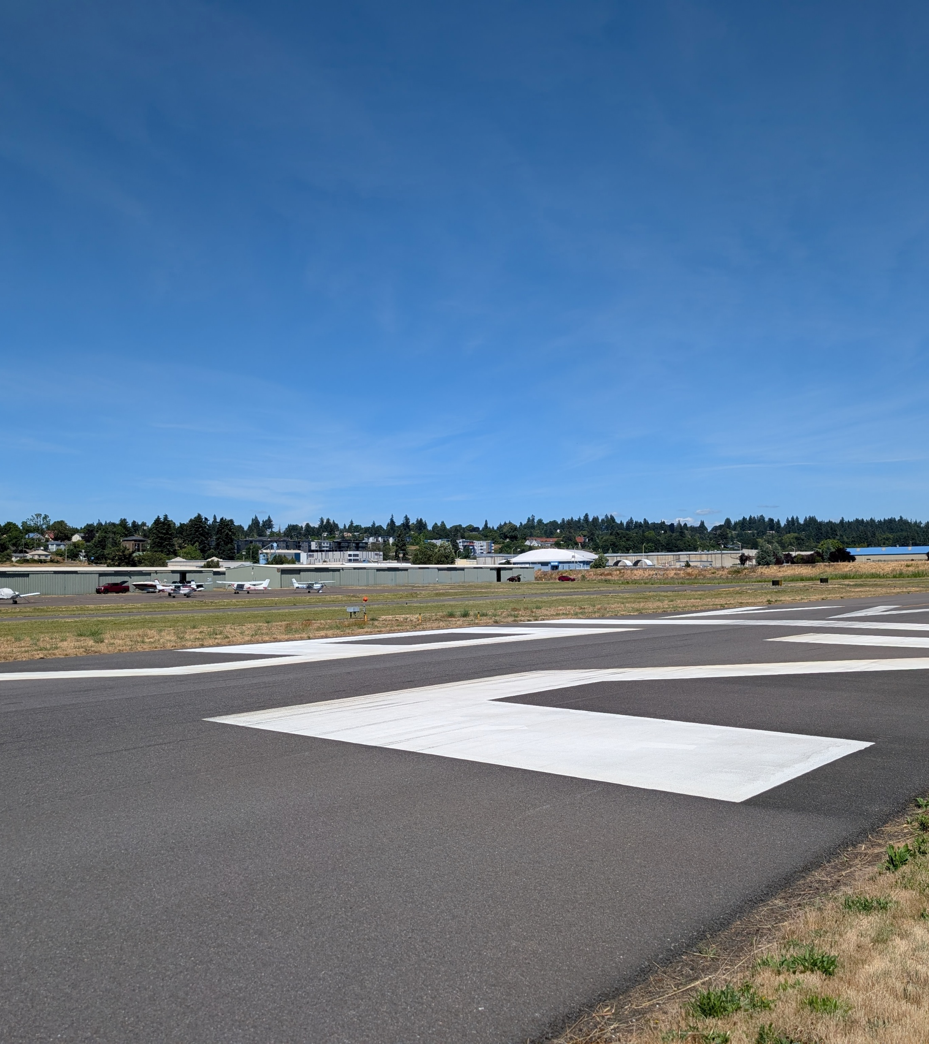

Pearson Field
Airport Master Plan
AAC Meeting 10.22.2026

Slide 2
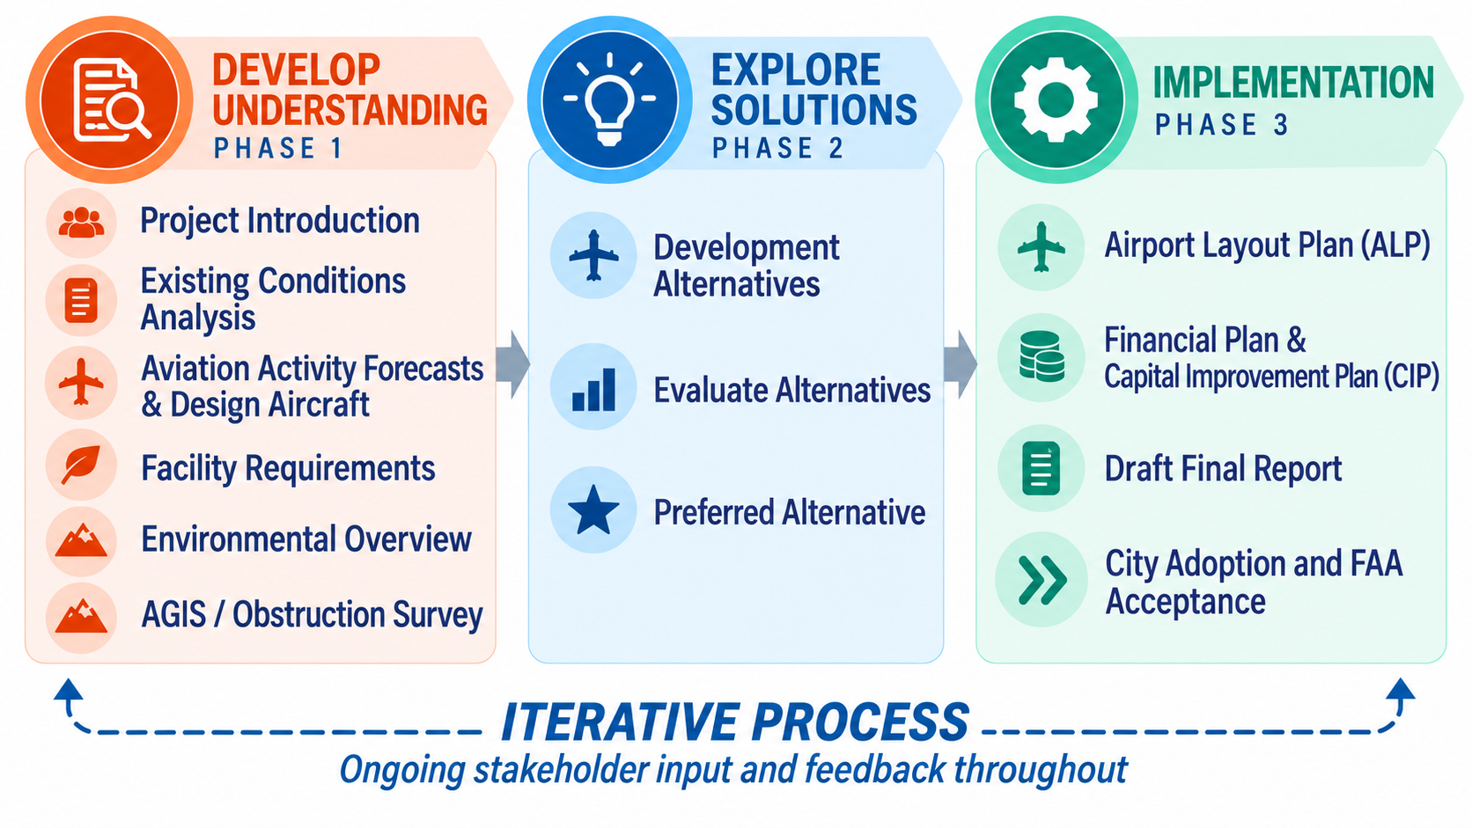
Airport Master Plan Process
This master plan is organized around three primary study phases that guide the planning process from documenting existing conditions through evaluation of alternatives and preparation of the implementation program.

Slide 3
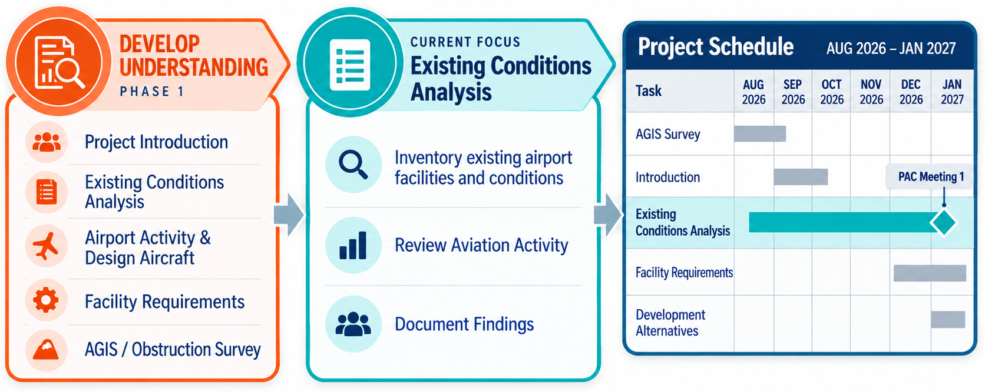
Next Steps

Slide 4
Airport Master Plan – Project Schedule

Slide 5
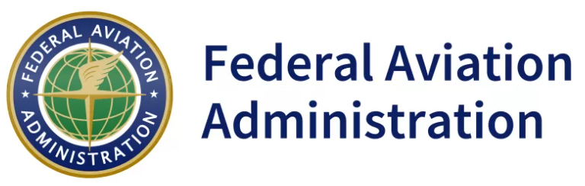




Airport Master Plan Project Team
ALP Approval Authority
Airport Sponsor
Airport Planning Consultant
Environmental Subconsultant
Aeronautical Survey Subconsultant

