Slide 1
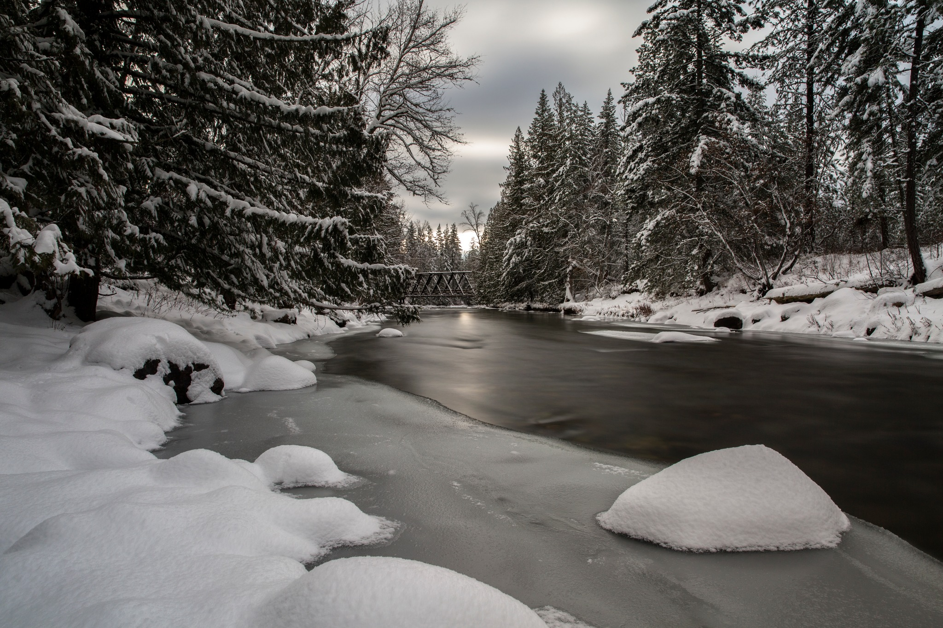

NORTH WESTSIDE GOVERNANCE & SERVICES STUDY
COMMUNITY OPEN HOUSE
Thursday, July 7, 2022
Columbia Shuswap Regional District
ELECTORAL AREA F ISSUES IDENTIFICATION STUDY
January 20, 2024

Slide 2
WELCOME
Electoral Area F Issues Identification Study
Local Government Today
Local Services Provided
Governance
Cost to Local Taxpayers
Next Steps in the Study

Slide 3
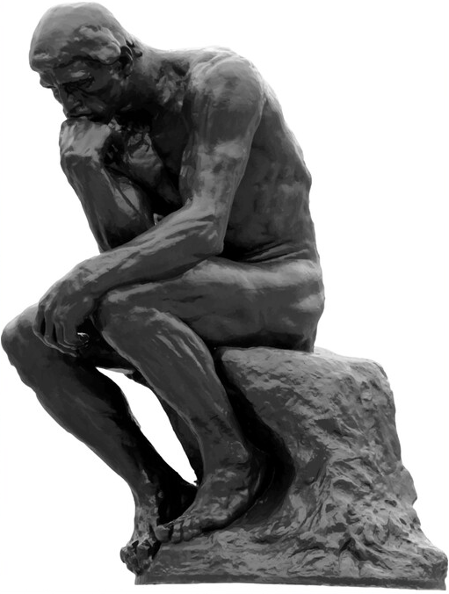
REFLECTION
Do you receive all the local services you need?
Do you feel that you receive good value for the property taxes you pay?

Slide 4
REFLECTION
Do you think that North Shuswap residents have enough input into service decisions?
What could the CSRD do to help address your service and governance concerns?

Slide 5
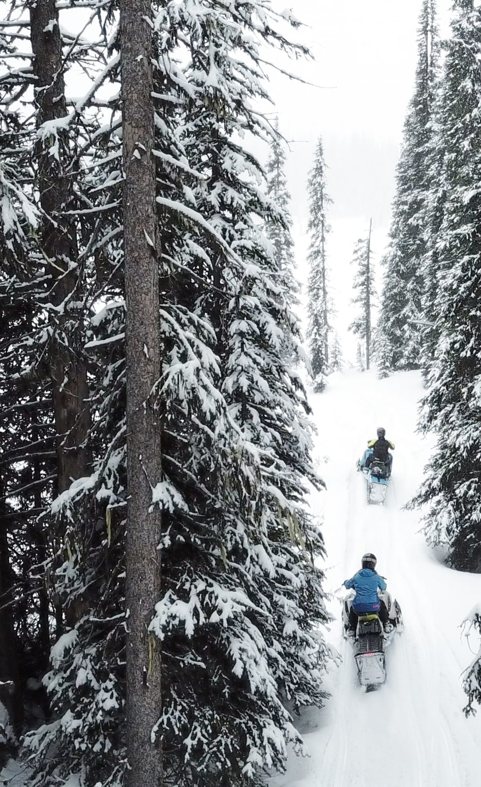
THE STUDY
Purpose of Study is threefold:
document and assess current governance and services ("what is")
Understand concerns and interests
Identify changes to consider within existing Regional District system

Slide 6
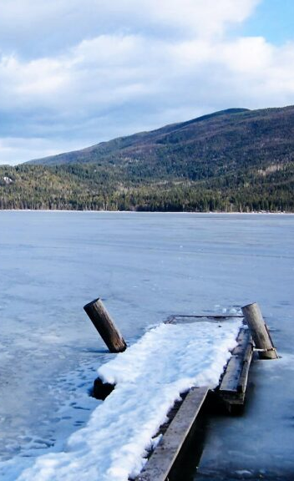
LOCAL GOVERNMENT

Slide 7
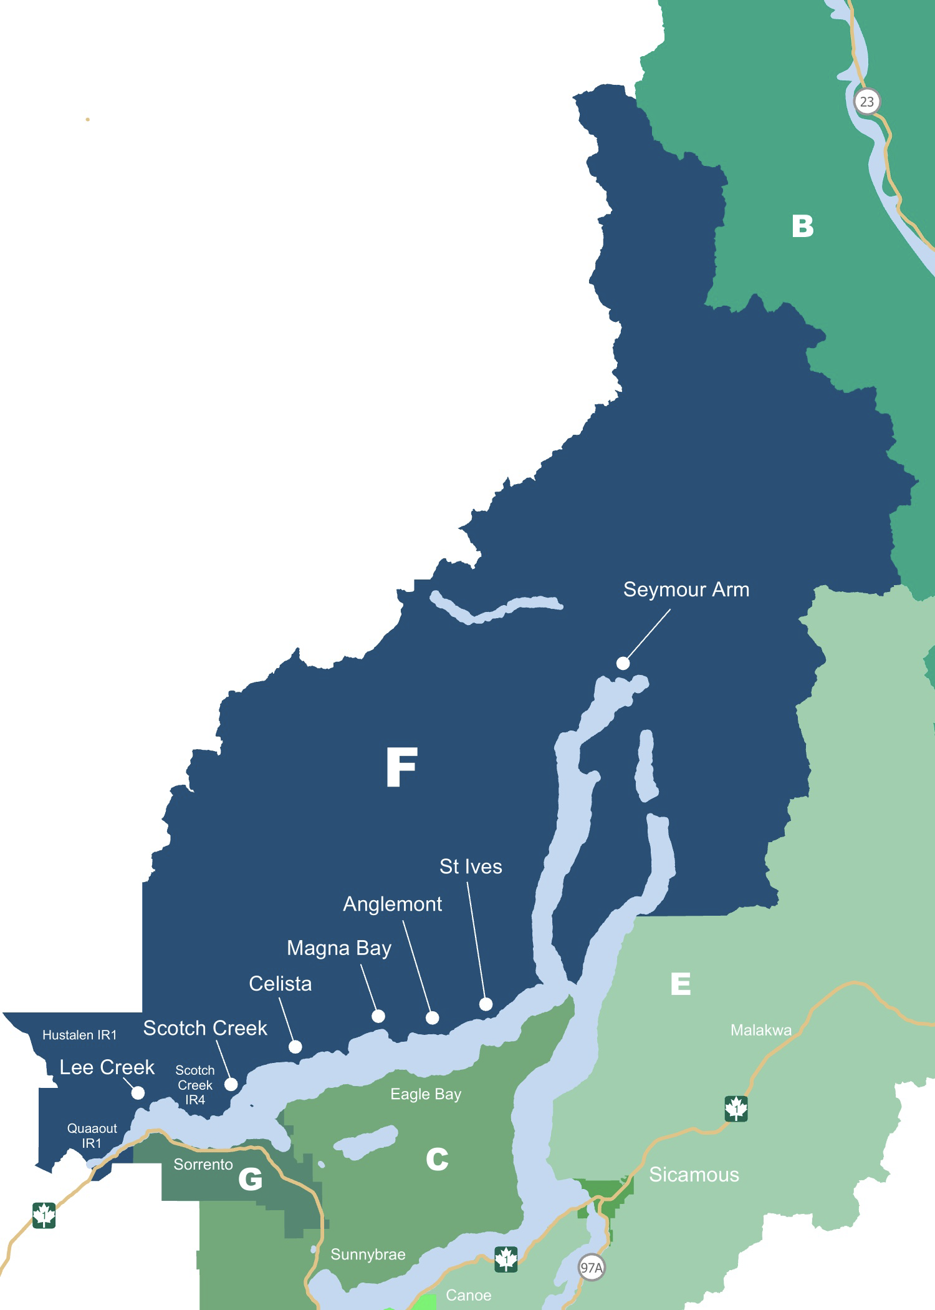
LOCAL GOVERNMENT
Electoral Area F (North Shuswap)

Slide 8
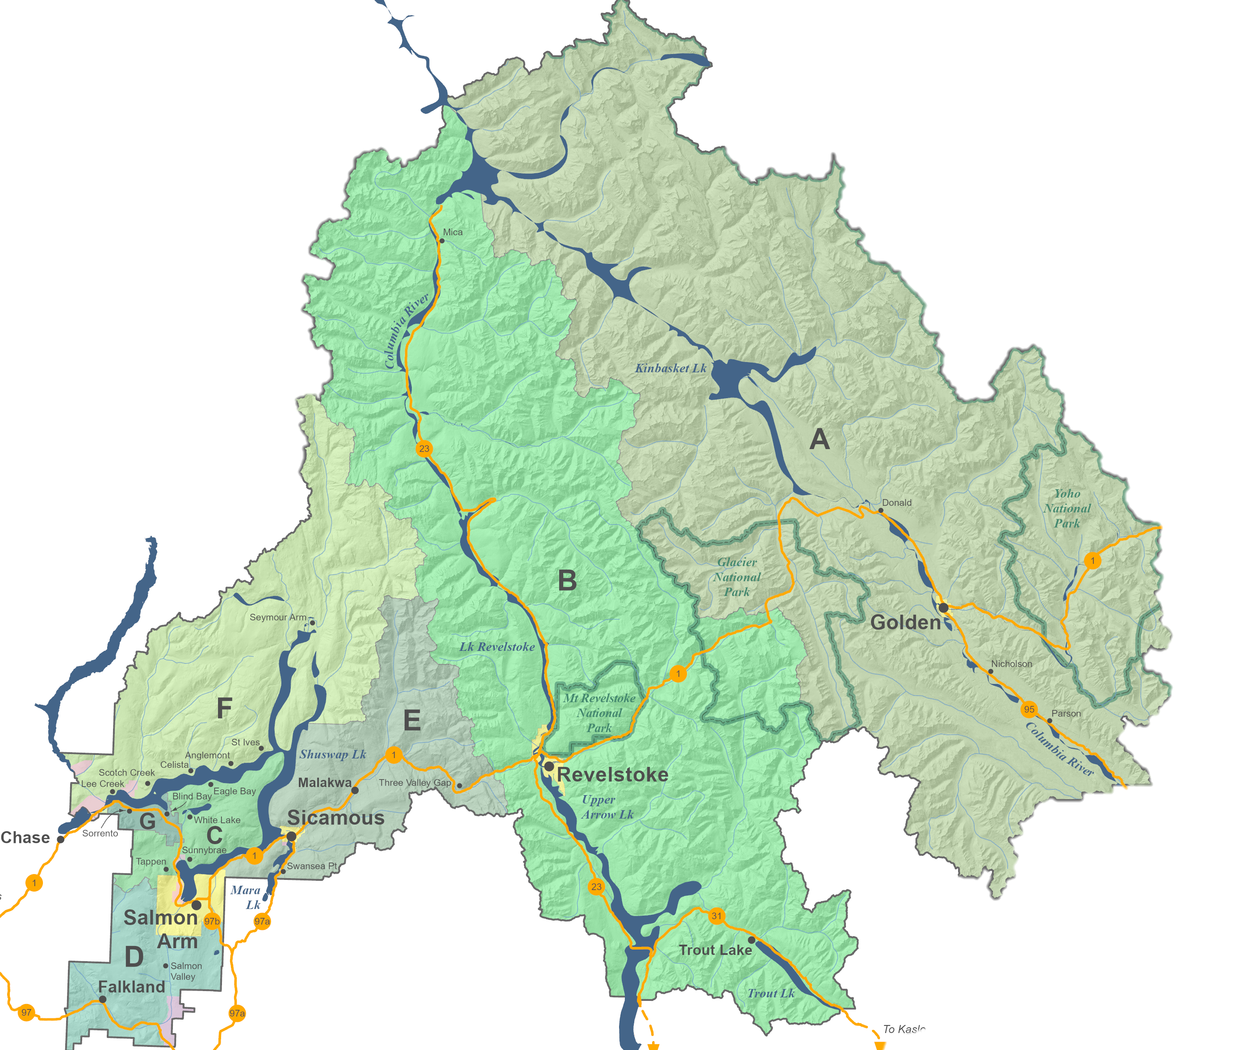
LOCAL GOVERNMENT
Electoral Area F (North Shuswap)
Columbia Shuswap Regional District
Federation of four municipalities and seven electoral areas
Governed by Board of Directors

Slide 9







ELECTORAL AREA DIRECTORS
A
B
C
D
E
F
G
MUNICIPAL DIRECTORS
Salmon Arm
Golden
Revelstoke
Sicamous

Slide 10
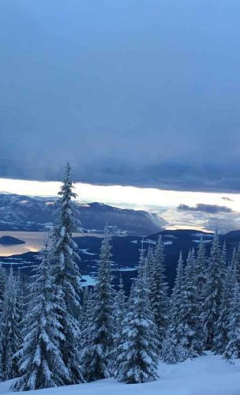
LOCAL SERVICES
Regional Districts exist to provide services in response to the needs of their members
local services to electoral areas (14 to Area F)
region-wide services (4 in CSRD)
sub-regional services (19 that include Area F)

Slide 11
LOCAL SERVICES
Province of British Columbia also provides some local services
local roads and subdivision approval
local policing
provincial parks and recreation sites
ambulance, education, health care

Slide 12
LOCAL SERVICES
Private services exist, too
50 private water systems

Slide 13
REGIONAL
SUB-REGIONAL
LOCAL

Slide 14

REGIONAL
SUB-REGIONAL
LOCAL

Slide 15

REGIONAL
SUB-REGIONAL
LOCAL

Slide 16

REGIONAL
SUB-REGIONAL
LOCAL

Slide 17

REGIONAL
SUB-REGIONAL
LOCAL

Slide 18
REGIONAL
SUB-REGIONAL
LOCAL

Slide 19
REGIONAL
LOCAL
SUB-REGIONAL

Slide 20
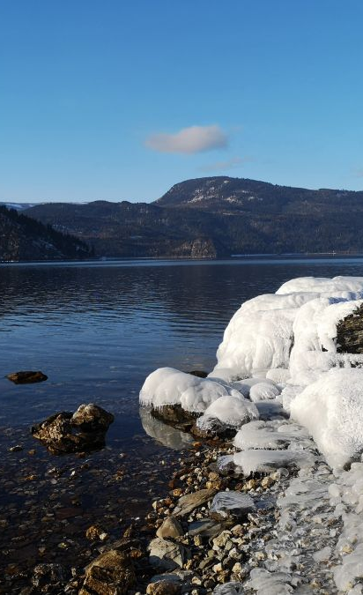
GOVERNANCE
Governance is all about decision-making
Who's involved in making them
How are they made

Slide 21
GOVERNANCE
In plain terms, governance is about control
how is control shared
how is control exercised

Slide 22

GOVERNANCE
Start with Who's Involved

Slide 23
GOVERNANCE
Two types of Regional District directors
Electoral Area Directors
Municipal Directors

Slide 24
GOVERNANCE
Each Electoral Area gets one director, regardless of size
Municipalities may have more than one director, based on size

Slide 25
GOVERNANCE
To determine the number for each jurisdiction, need to consider
jurisdiction's population
the Regional District's voting unit (2,500 people)

Slide 26
ELECTORAL AREA DIRECTORS
A
B
C
D
E
F
G
MUNICIPAL DIRECTORS
Salmon Arm
Golden
Revelstoke
Sicamous

Slide 27
GOVERNANCE
Decisions made (control exercised) through voting
Corporate Unweighted Votes
Corporate Weighted Votes
Stakeholder (Weighted) Votes
If service provided to only one jurisdiction or part of jurisdiction, whole board votes (corporate unweighted)

Slide 28
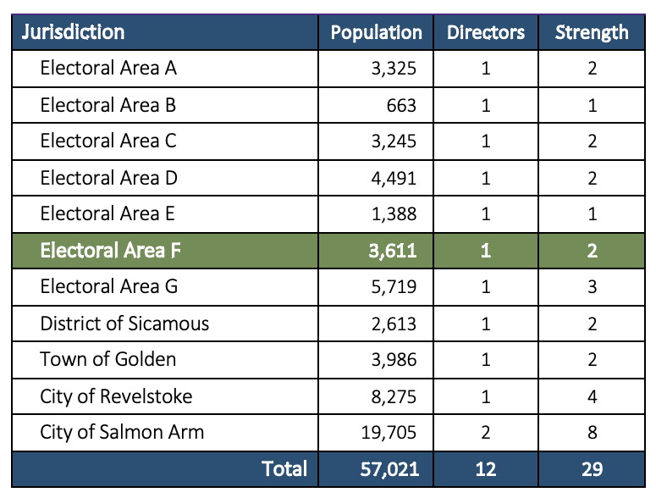

Slide 29
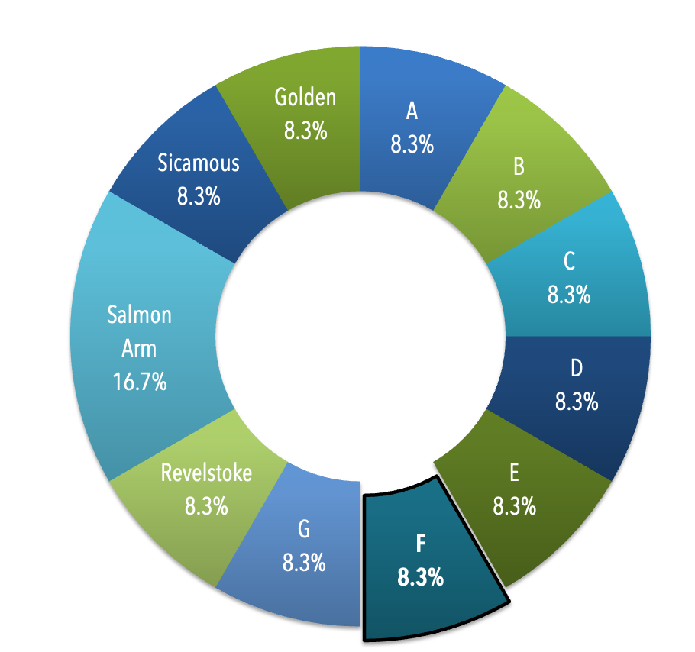
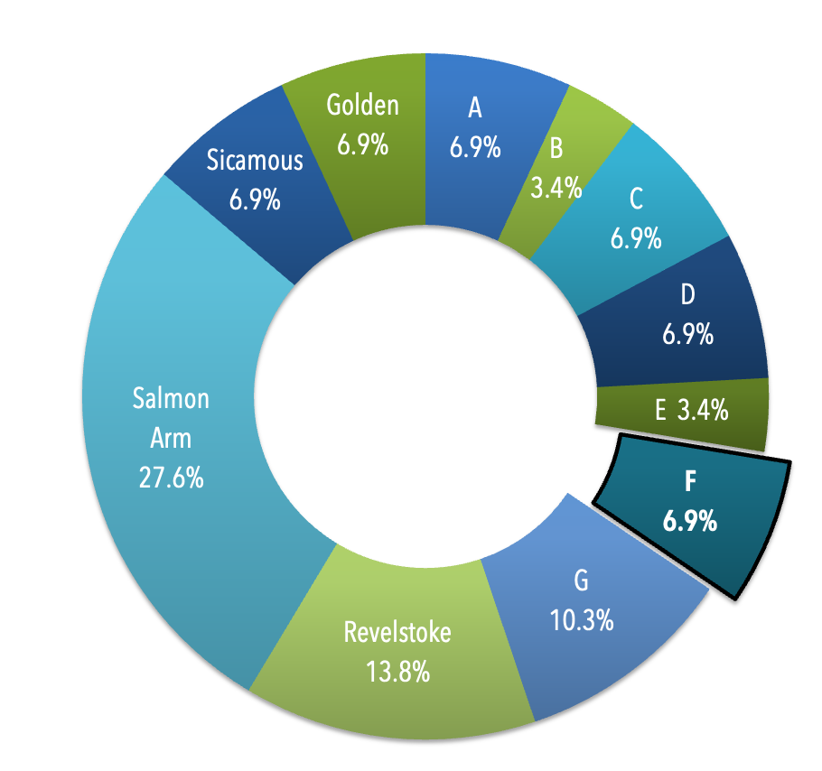
UNWEIGHTED VOTES
WEIGHTED VOTES

Slide 30
COST TO TAXPAYERS

Slide 31
COST TO TAXPAYERS

Slide 32
NEXT STEPS
Online survey available until end of February
Report in March to CSRD and Province
All materials available online

Slide 33

csrd.civilspace.io

Slide 34
REFLECTION

Slide 35
REFLECTION

Slide 36
NORTH WESTSIDE GOVERNANCE & SERVICES STUDY
COMMUNITY OPEN HOUSE
Thursday, July 7, 2022
Columbia Shuswap Regional District
ELECTORAL AREA F ISSUES IDENTIFICATION STUDY
January 20, 2024

