Slide 1
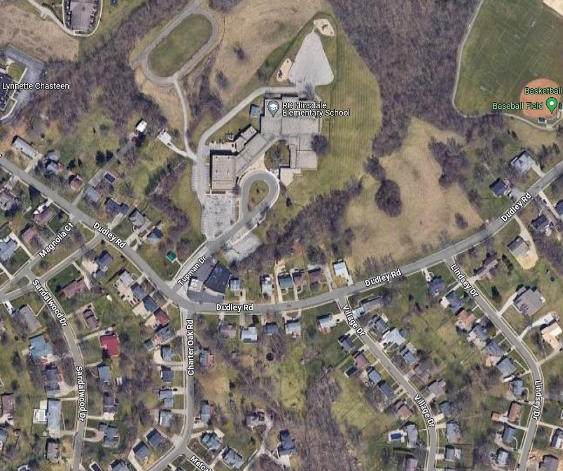
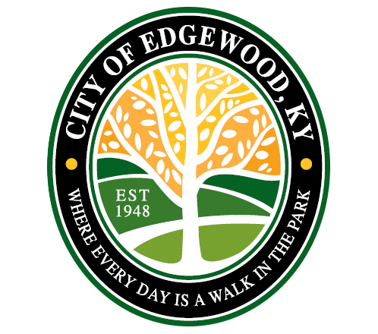

City of Edgewood
RC HINSDALE ELEM. SCHOOL
DUDLEY ROAD AND CHARTER OAK DRIVE INTERSECTION IMPROVEMENTS
Public presentation
March 3, 2025
DUDLEY RD
CHARTER OAK RD

Slide 2
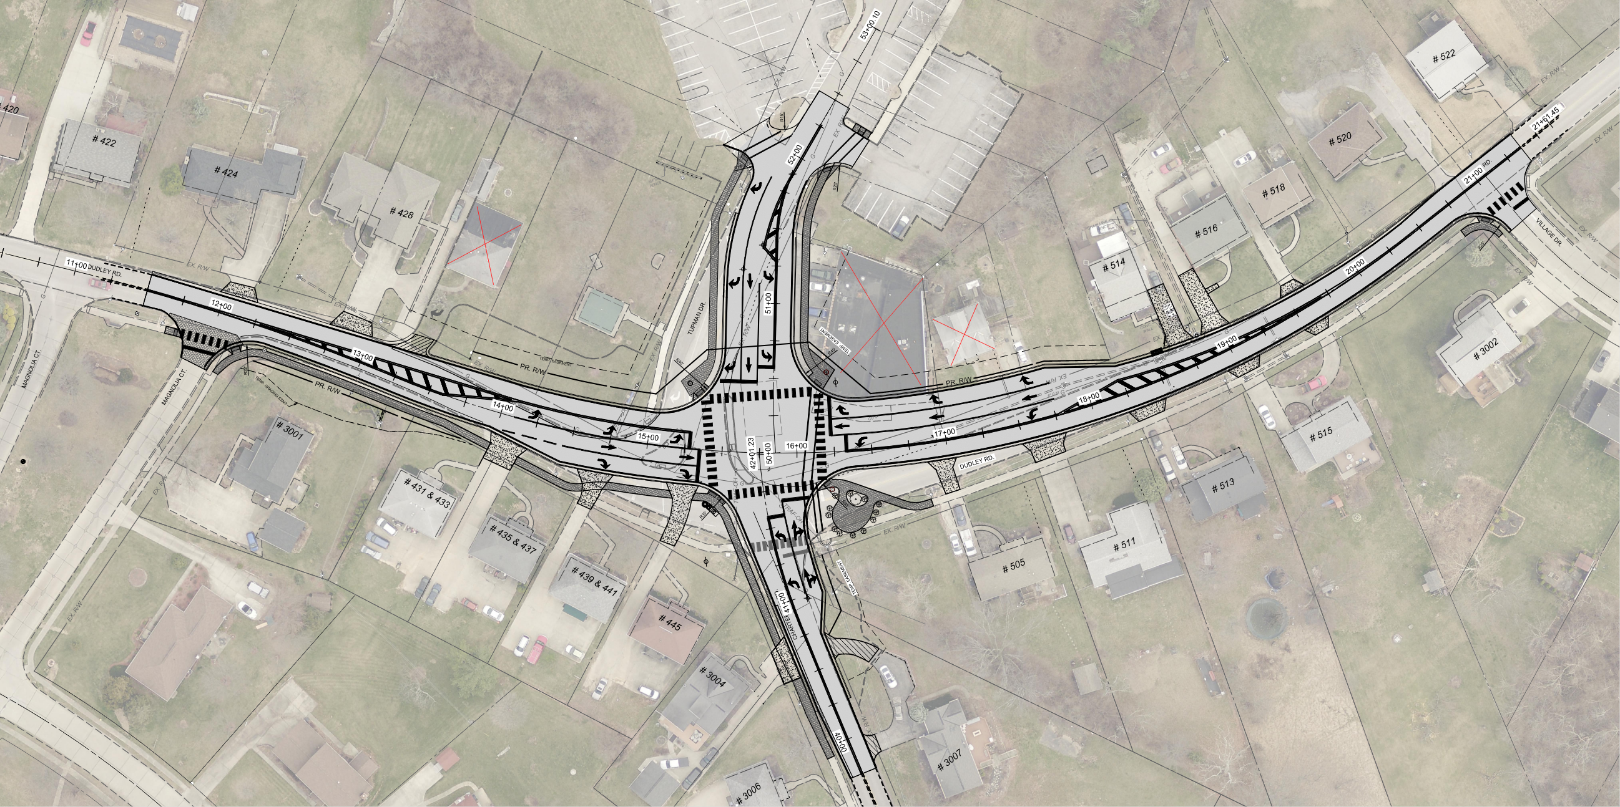
Intersection Improvements

Slide 3
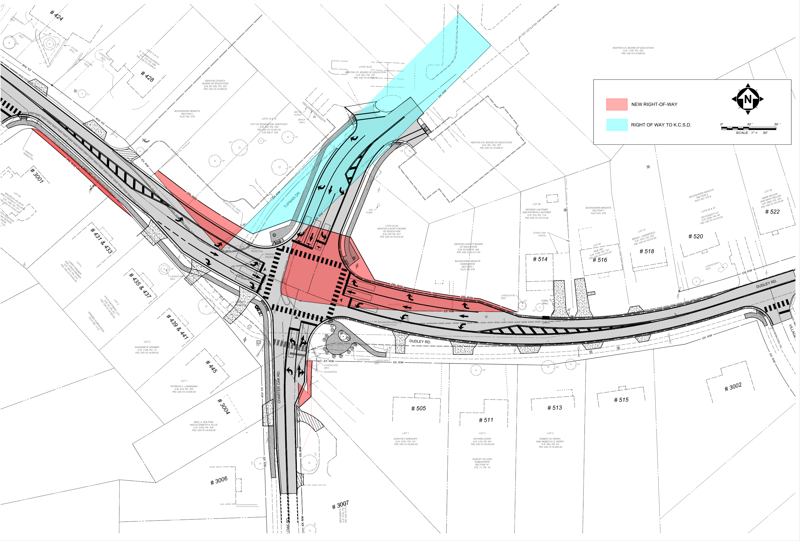
Right of Way Needs

Slide 4
Intersection Project Goals
Straighten out the sharp curve along Dudley
Add Turn Lanes along Dudley to increase capacity
Align Tupman Drive with Charter Oak Road
Upgrade Traffic Signals
Increase Traffic Flow and reduce delay through intersection
Improve Pedestrian Safety and Visibility
Improve Access to RC Hinsdale

Slide 5
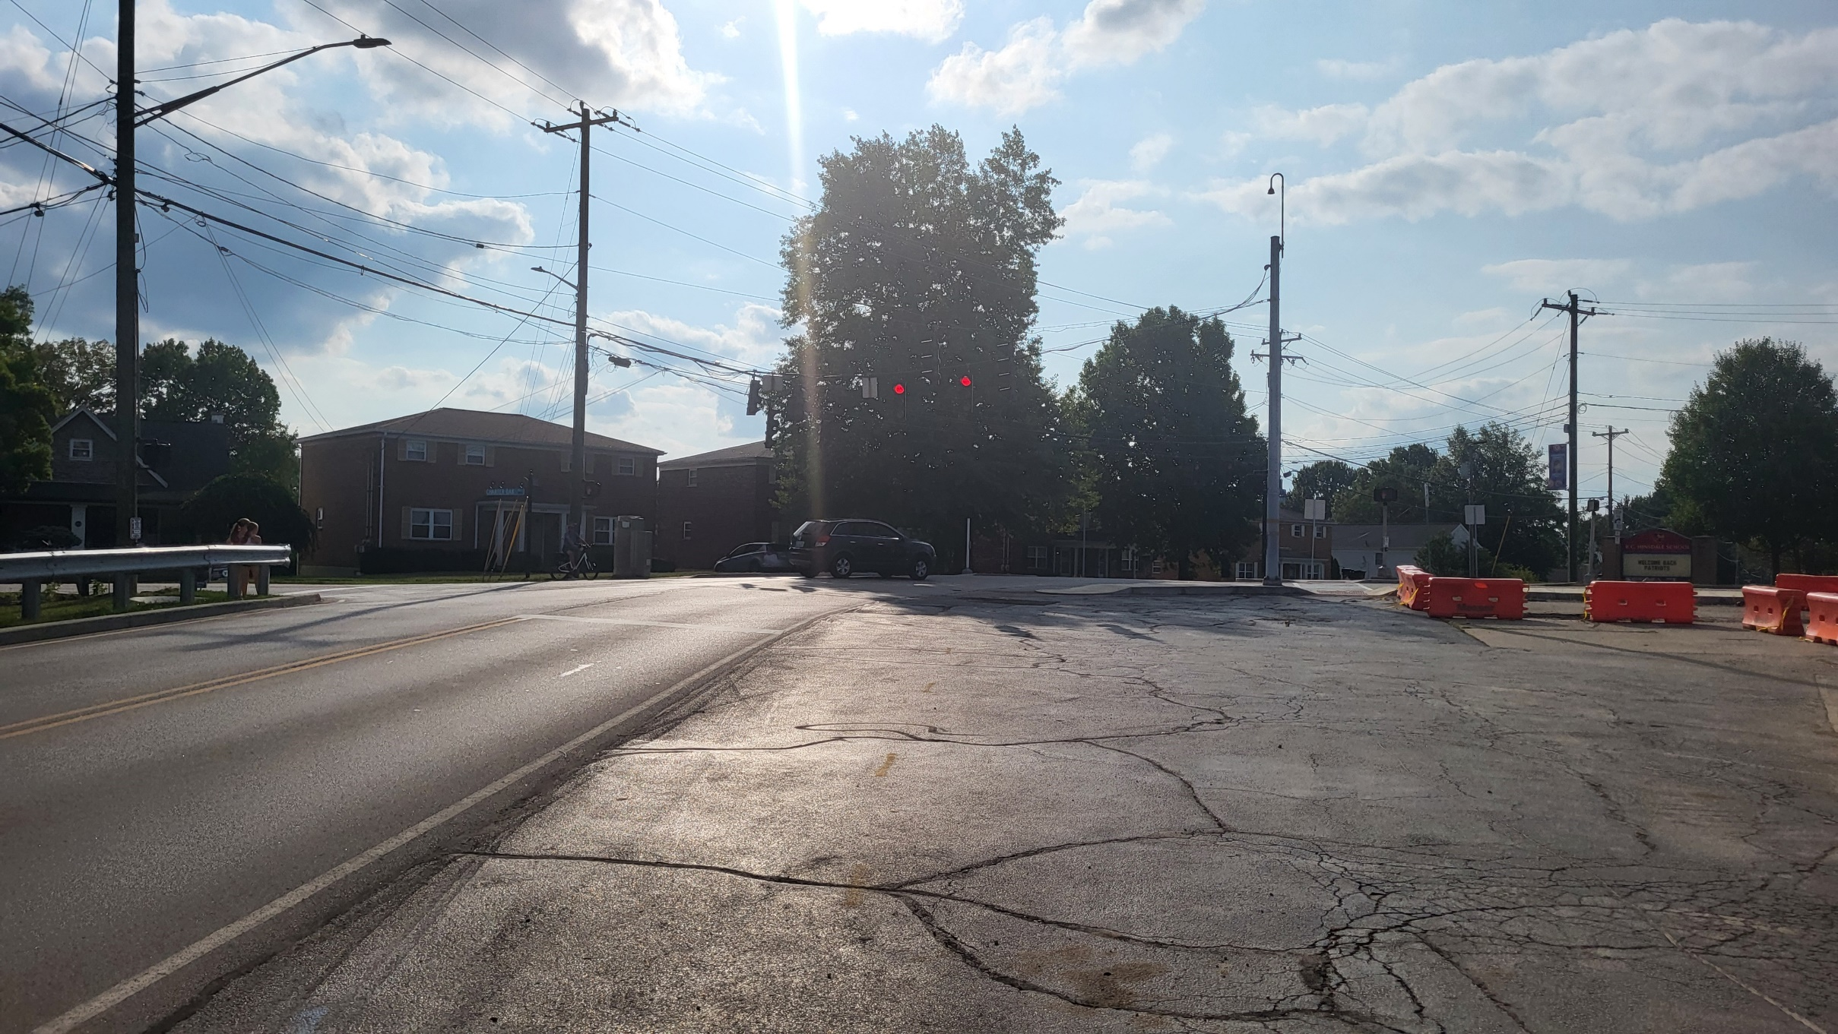
Sharp Curve on Dudley/No Turn Lanes

Slide 6
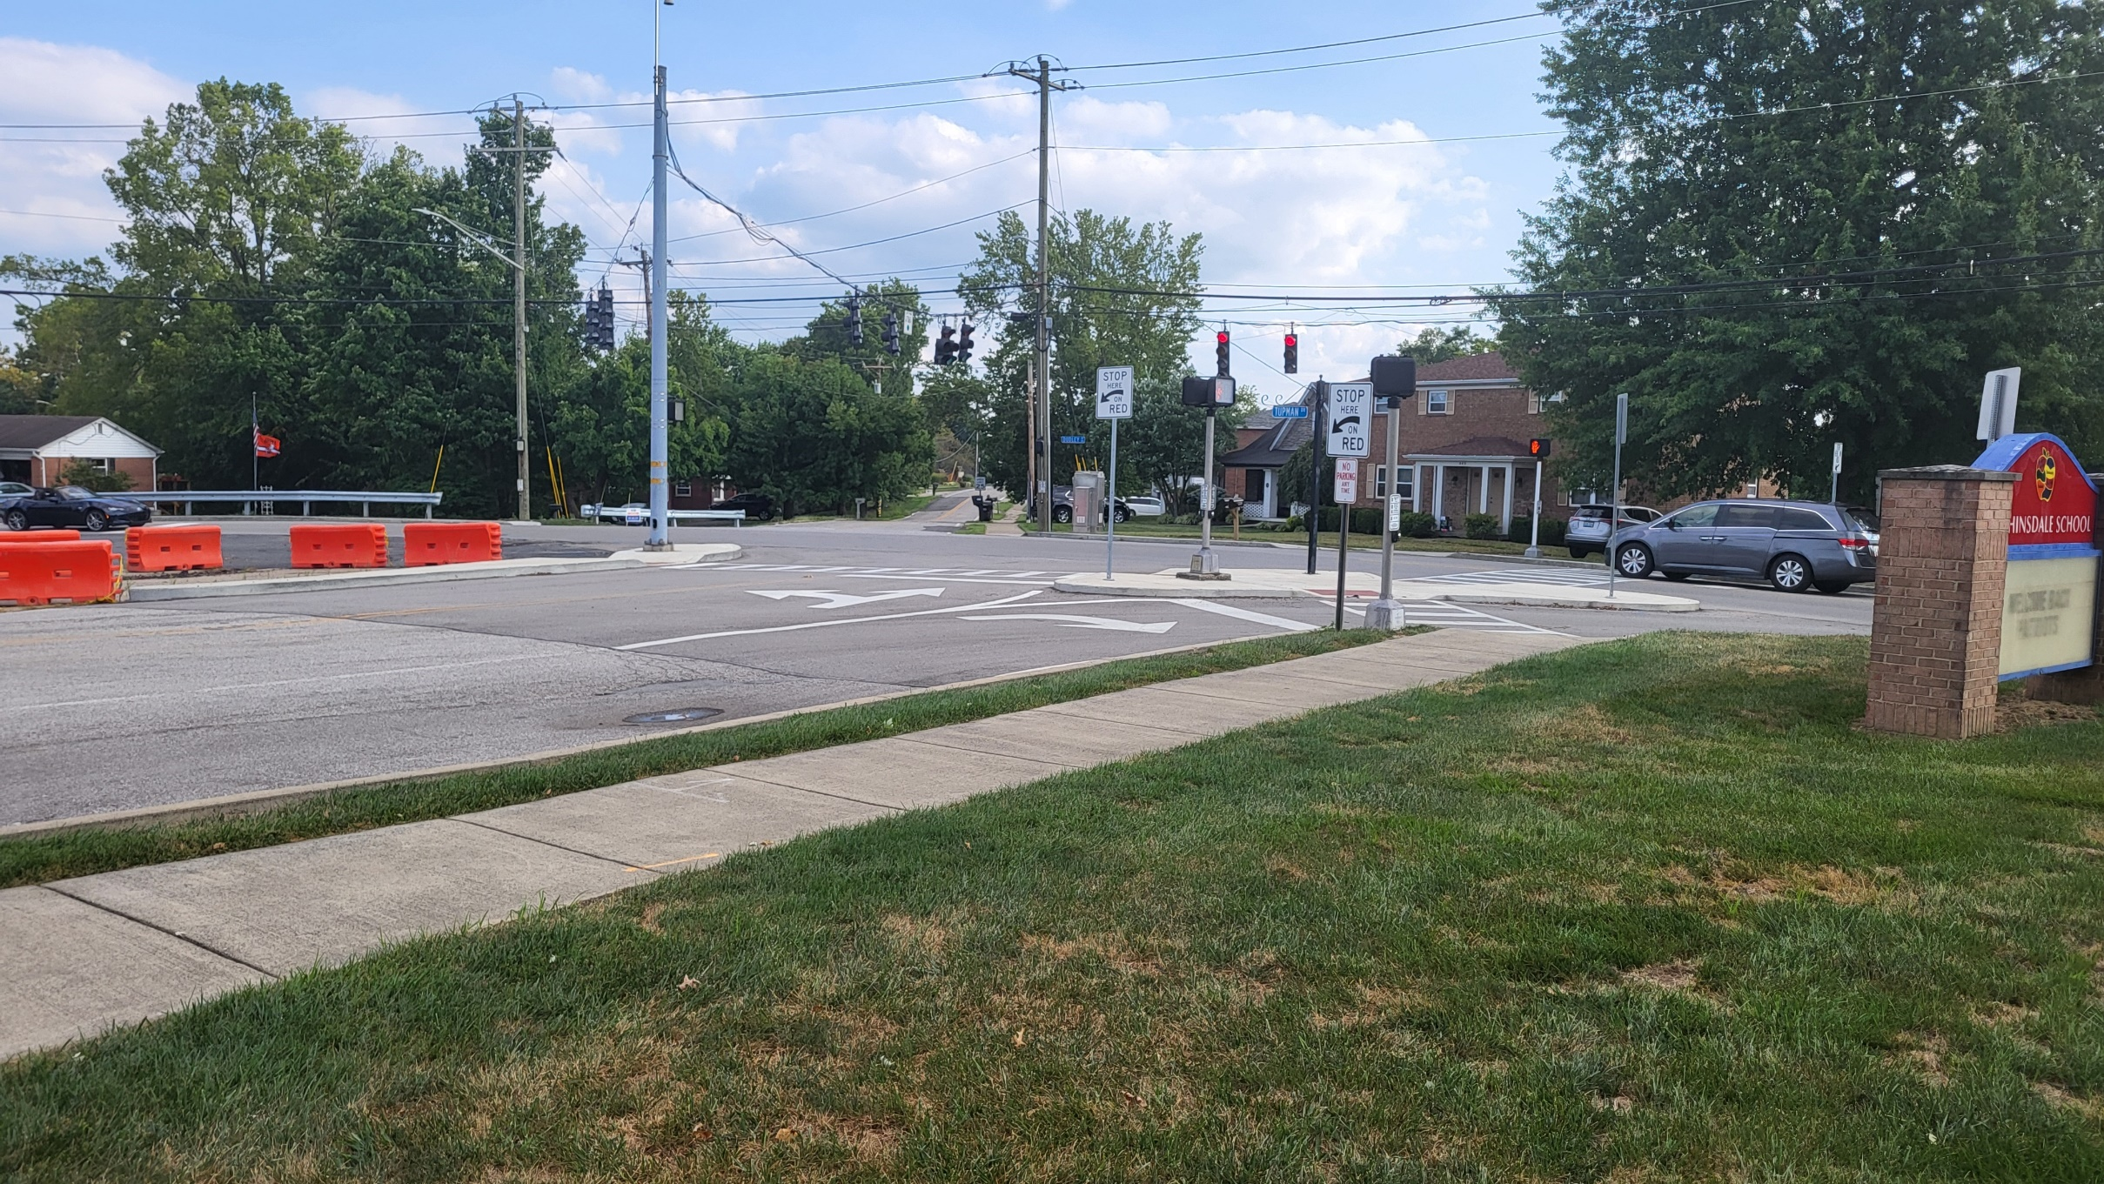
Tupman / Charter Oak Not Aligned

Slide 7
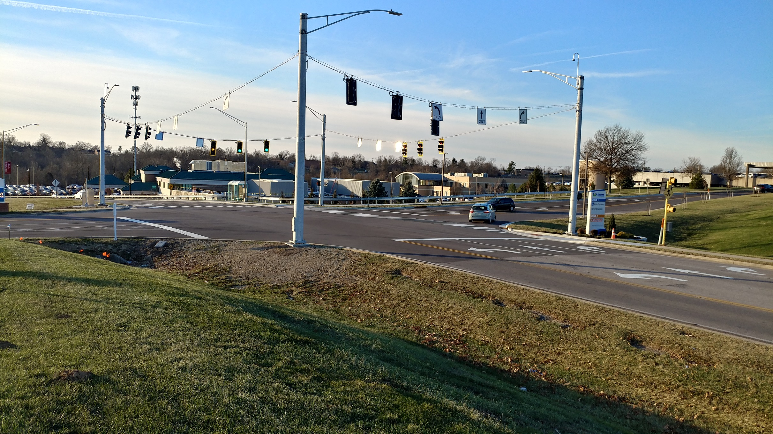
Traffic Signals/Lighting
THOMAS MORE PARKWAY AT ST. ELIZABETH ENTRANCE

Slide 8
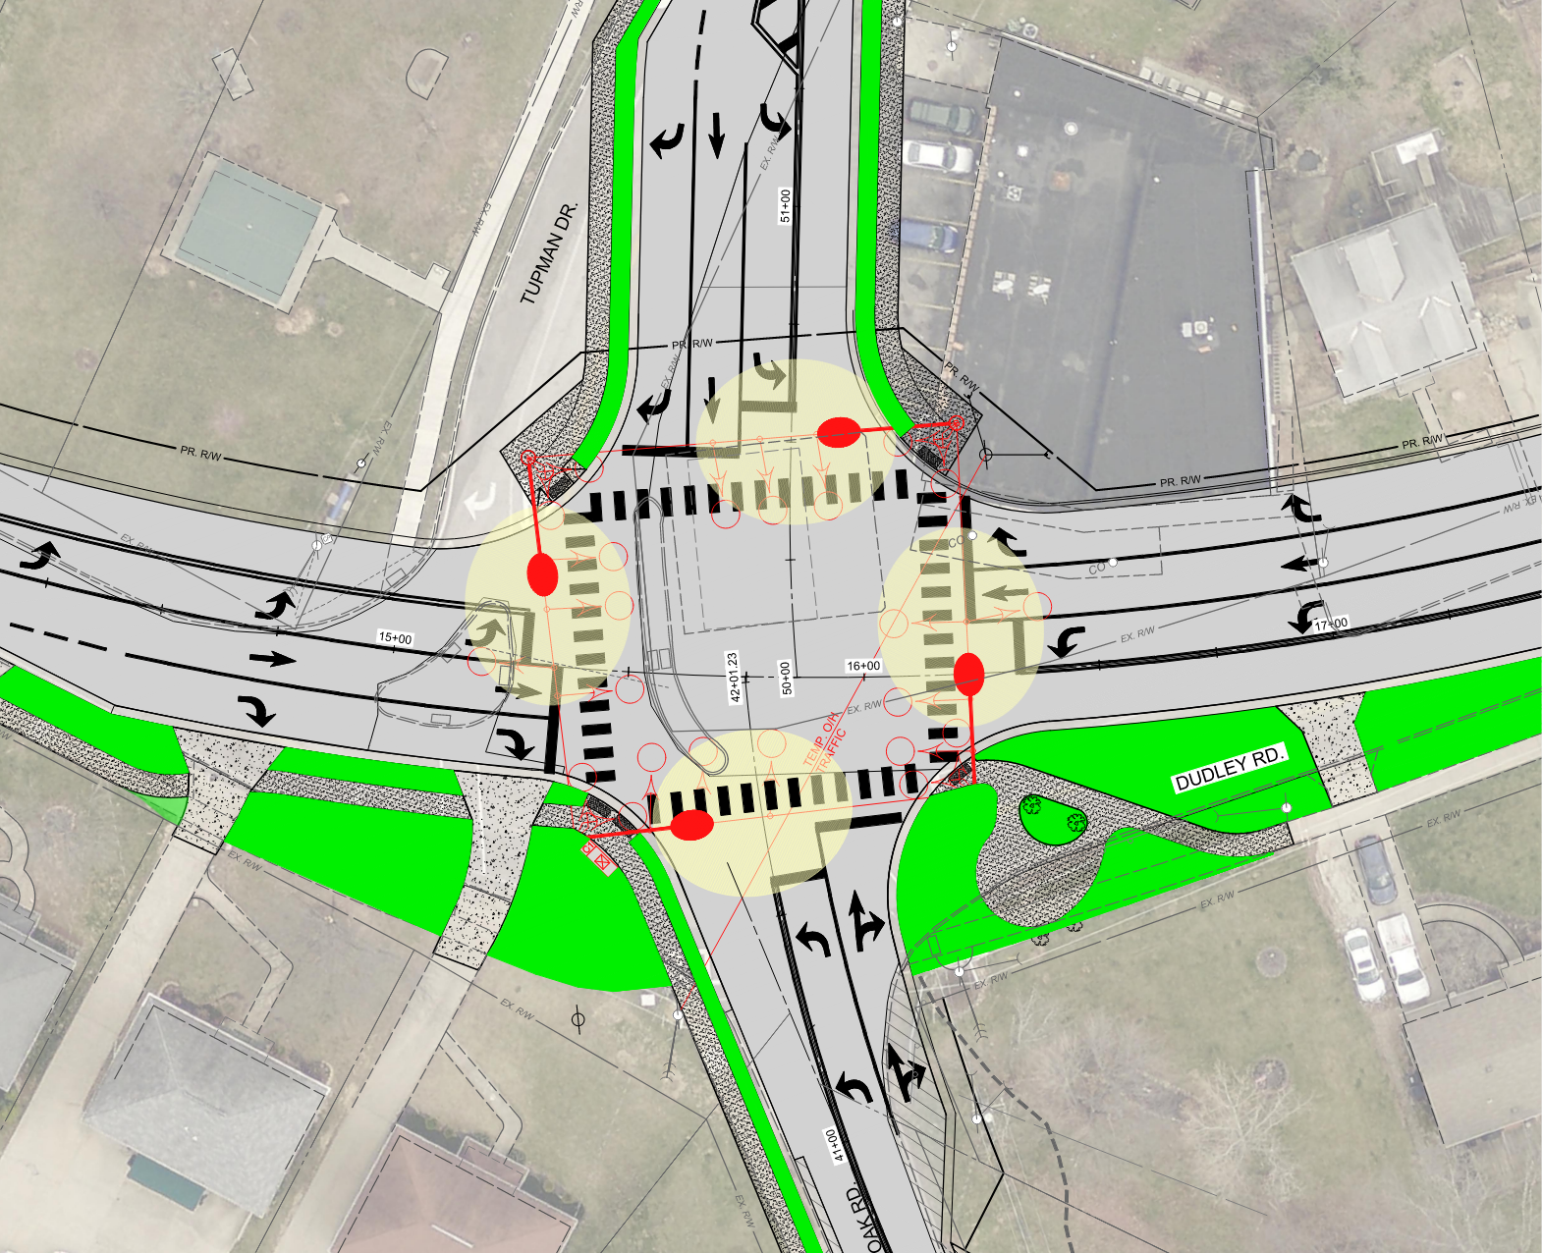
Traffic Signals/Lighting
THOMAS MORE PARKWAY AT ST. ELIZABETH ENTRANCE

Slide 9
Project Schedule/Cost
Finalize Right of Way: March 2025
Project Bid: March 6, 2025
Open Bids: March 27, 2025
Construction: April – October 2025 (Majority of work to take place during school summer break)
Preliminary Opinion of Construction Cost: $1.2 Million

