Slide 1


Welcome to the Getty St. Round Table
Date: October 29, 2025
Purpose: To foster collaboration between the business community, city staff, and stakeholders to enhance the Getty St. Corridor
Please Sign in
Grab Lunch Provided by Getty Street Grill
Notes:
Hi everyone, thank you so much for being here today! I know how busy your days areb, so I appreciate you all taking the time out of your day to collab with your fellow getty st business owners. Lunch is from getty st grill, salads and soup, so please help yourself and get comfortable.

Slide 2
Agenda
Welcome & Introductions
  Recap of the First Getty Street Meeting
Overview of City Departments
Corridor Associations and Improvement Examples
Open Floor: Business needs, ideas, priorities for Getty
Next Steps and Continued Meetings
Notes:
“Today’s agenda is pretty straightforward. We’ll first do introductions, then move into a recap of the first Getty meeting, which was about eight months ago. I included the minutes in your packet—we’ll touch on them briefly before jumping into an overview of the Planning and Economic Development teams. We’ll highlight the work both departments do and how they connect with the business community.
Next, we’ll talk about why we’re here today: Corridor and Business Associations, and some examples of the kinds of improvements they fund. Lastly, we’ll have an open-floor conversation about business needs, ideas, and priorities for Getty. We’ll wrap up by setting a date for our next meeting.”

Slide 3
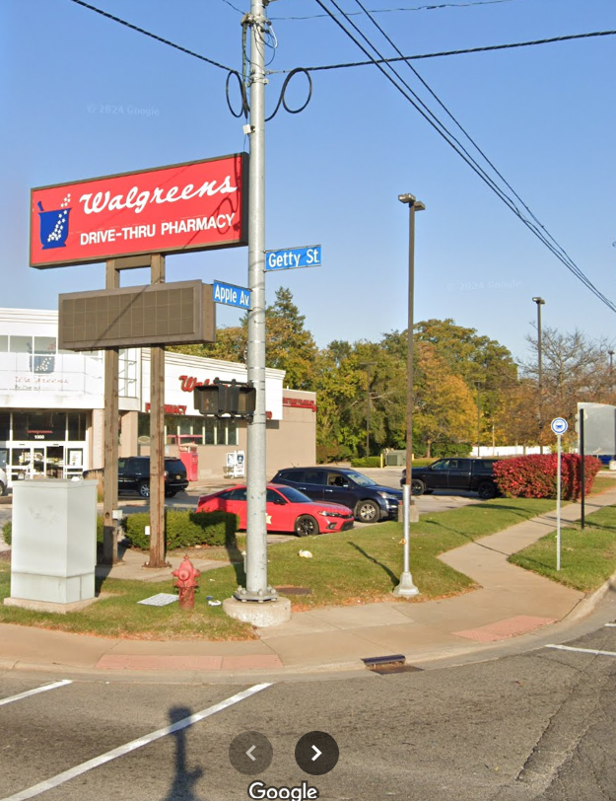
Introductions
Brief welcome and attendee introductions
Purpose of the round table discussion
Your Name
Organization/Business
Describe what you love about the Getty St. Corridor
Notes:
Slide 3 – Introductions & Recap
“For introductions, let’s keep it short—please share your name, your organization or business, and one word that describes what you love about Getty Street.
Now, for a quick recap of the last meeting. My predecessor, Contessa, helped bring everyone together. Planning’s role was a big part of the discussion, along with Economic Development. There was also a public safety update with some helpful tips—especially around the importance of security cameras.
The Apple Avenue redesign was another big topic. The plan included reducing lanes after Getty and transitioning to two lanes after Wood Street. A 2022 traffic study also looked at Getty, but lane reductions there are not on the table—so you can take a deep breath on that one.
Finally, there was some conversation about Getty’s identity and what improvements might be needed. We’ll dive more into that today. At the bottom of the minutes, you’ll find staff contact information if you’d like to follow up with anyone.
Now, to get us started, Mike will give an overview of Planning, and then I’ll cover Economic Development.”

Slide 4
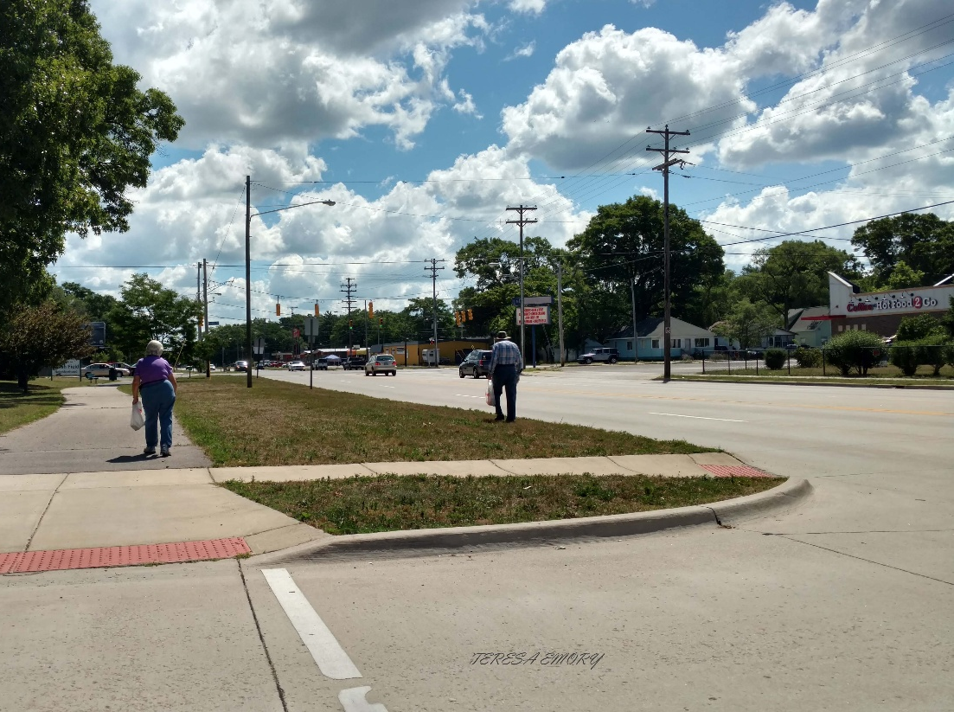
Meet the Economic Development & Planning Department
Overview of the department's roles
Key projects and initiatives in the area
How the department supports community growth
Notes:
Our priority in Economic Development is to attract, retain, and expand businesses within the City of Muskegon. We do this in very direct ways—through one-on-one visits where we sit down with business owners, learn about your needs, and figure out how we can help. Sometimes that means connecting you with resources or funding opportunities, sometimes it’s helping you navigate city processes, and sometimes it’s just being a sounding board so your concerns are heard.
One of our biggest current pushes is housing. Large projects like Shaw Walker and Windward Pointe are in the works to meet growing demand and bring more residents into the city. This not only addresses our housing shortage but also strengthens the customer base for local businesses.
Another initiative is building stronger connections within the business community itself. Meetings like today are part of that—bringing business owners together to share ideas and consider collective tools. Corridor Improvement Authorities (CIAs) and Business Improvement Districts (BIDs) are two of those tools. Our department often serves as the liaison to help organize these efforts, walk business owners through the process, and support boards once they’re established.
At the end of the day, everything we do is about strengthening Muskegon’s economy. By supporting businesses, encouraging investment, and facilitating projects like housing or corridor improvements, we grow the tax base, retain our workforce, and give the city the resources to provide stronger services. That creates a ripple effect that benefits businesses, residents, and the entire community.”

Slide 5
Corridor Improvement Authorities & Business Improvement Districts
BID (Business Improvement District):
Funded by special assessments on businesses within the district.
Dollars go directly back into the corridor (events, beautification, marketing).
Limited in scope—short-term, lighter-touch improvements.
Ends once the designated term expires unless renewed.
CIA (Corridor Improvement Authority)
Funded by Tax Increment Financing (TIF).
Uses growth in property tax values to reinvest in the corridor.
Allows for larger, long-term infrastructure and redevelopment projects.
Can finance improvements like sidewalks, lighting, parking, landscaping, and even façade grants (public-facing).

Slide 6
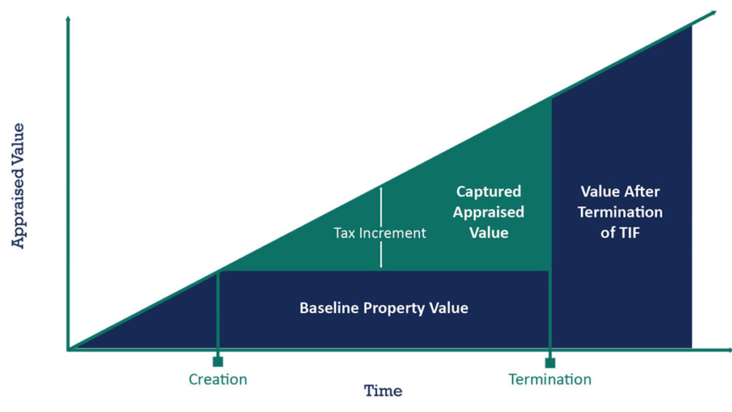
Tax Increment Financing Visual

Slide 7
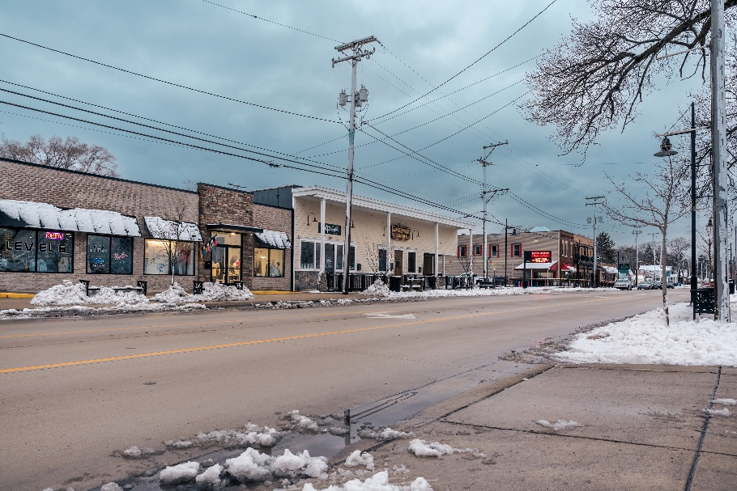
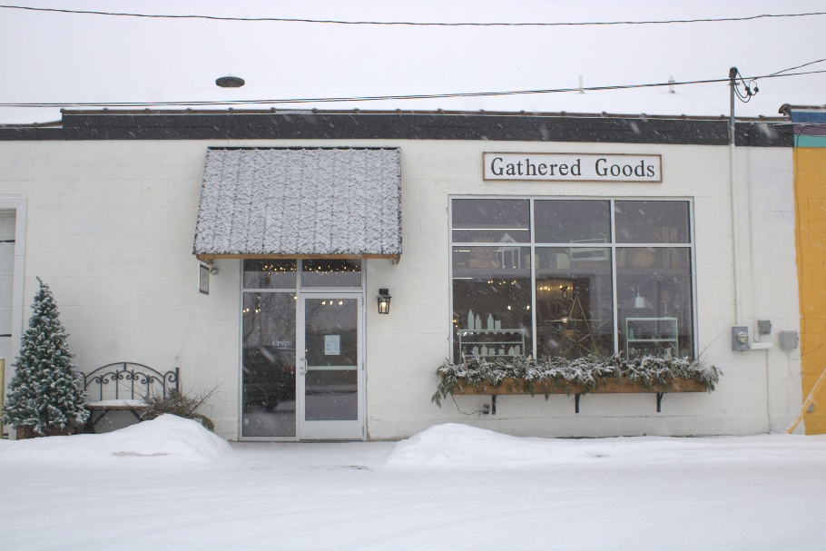
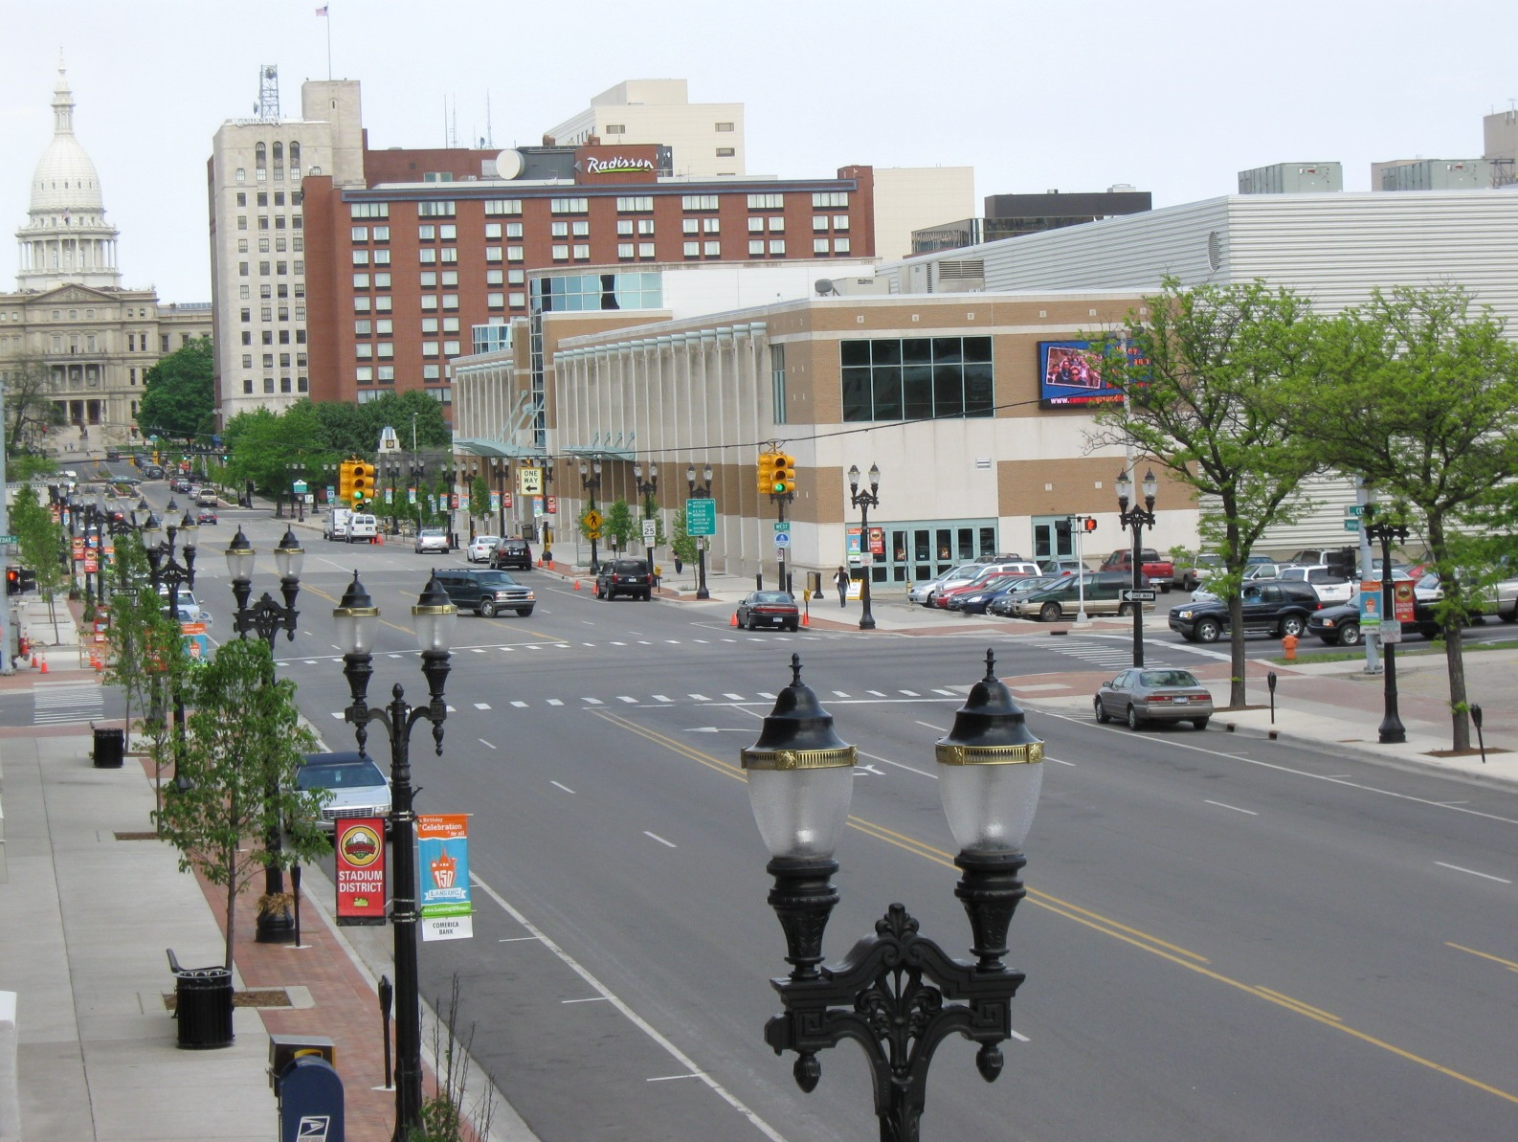
Improvement Examples
Lakeside BID/CIA funds snowplowing of sidewalks
Muskegon DDA funds a matching 1 to 1 façade grant
Michigan Avenue CIA in Lansing funds streetscaping & landscaping
Notes:
Here are some real-life examples of what these tools can do.
In Lakeside, their BID funds sidewalk snowplowing so businesses don’t each have to figure it out themselves—it’s taken care of collectively. They also use both a BID and a CIA, either separately or together, so they can address short-term needs while building TIF dollars for the future.
In Downtown Muskegon, the DDA uses TIF funds for a one-to-one façade grant program. If a building owner has a $50,000 project, they cover half and the DDA covers the other half. That makes reinvestment much more doable.
And in Lansing, the Michigan Avenue CIA used funds for streetscaping—brick terraces, tree plantings, pole banners, the kinds of things that completely change how a corridor feels.
So these examples show the range—whether it’s snowplowing, building updates, or major streetscaping, BIDs and CIAs can create visible improvements that benefit the whole corridor.”

Slide 8
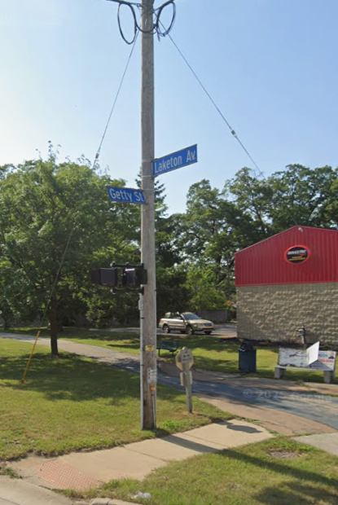
Identity & Vision for Getty St.
Community Branding and Identity
What improvements do you want to see? (Updated sidewalks, bike paths, more parking etc.)
Vision and Goals
Notes:
Community Branding & Identity
What should people think of when they hear “Getty Street”?
What makes this corridor unique?
Vision for the Corridor
What improvements do you want to see?
Safer sidewalks, crosswalks, or bike paths
More parking or better traffic flow
Landscaping, lighting, or public art
Events or branding that bring people here
Goals & Next Steps
Define shared priorities today
Guide future planning and investments

Slide 9



Thank You!
Isabela Gonzalez
231-724-4141
Isabela.Gonzalez@shorelinecity.com

