Slide 1

CRRF Workgroup Info Session
Thursday, July 9, 2026
6:00 – 8:30 p.m.
Elite Gymnastics & Recreation Center
Facilitated by:
Renesha Miles, Chief Equity & Access Officer
Elaine Pollard, Equity & Access Coordinator
Charles County Office of Equity & Access
Department of Human Resources

Slide 2

Tonight’s Agenda
Welcome/Dinner Served* 6:00 p.m.
CRRF Info Presentation 6:15 p.m.
Community Conversation* 6:30 p.m.
Closing Remarks/Next Steps 8:00 p.m.
*Please help yourself to food and refreshments at any time during the meeting. Note formal breaks are built in for planning purposes however, attendees may pause or break as needed.

Slide 3
What is the Community Reinvestment & Repair Fund?
A new opportunity that will help build the capacity for an upward mobility initiatives making a positive impact on our community.
In 2023, the Maryland General Assembly approved the Cannabis Reform Act, which created an additional stream of funding for all counties in Maryland, including Charles County. This new funding is called the Community Reinvestment and Repair Fund (CRRF).
Now that Charles County has access to additional funding from the state of Maryland, we are engaging with the community to decide how to best use this money for programs and initiatives.

Slide 4
State of Maryland CRRF Guidelines
CRRF is funded with money from taxes on adult-use cannabis. Maryland now imposes a 9 percent sales tax on legal adult-use of cannabis and a portion of these revenues are provided to the counties for them to manage a CRRF.
This money is given to local areas to support programs that help low-income communities and those most affected by past cannabis laws.
This funding MUST be used in the following identified “impacted areas” the 20601, 20602, 20603 zip codes.
Potential uses of this funding include allocation to mental health and substance abuse programs, education, youth and family services, public health, community organizations, and housing and homelessness preventions services.
This funding can NOT be used for law enforcement or to supplement funding that already exists in Charles County's budget.

Slide 5

Charles County’s Approach to CRRF
The Office of Equity & Access manages Charles County Government’s CRRF plan and process.
A CRRF Workgroup was created last year to help the Office of Equity & Access engage the community, assess needs, and make funding recommendations.
The CRRF Workgroup is a diverse group of community stakeholders and Charles County Government staff who help the Office of Equity & Access engage with the community and determine the most effective use of CRRF funds each fiscal year.

Slide 6
CRRF Workgroup Members
Subject Matter Stakeholders
Christie Burnett, Executive Director
Charitable Trust
Sara Carruth, Director of Criminal Justice Programs
Charles County Circuit Court
Valarie Dent, Health, Equity, and Access Coordinator
Charles County Health Department
KennethWayne Thompson, Executive Director
Charles County Public Library
Traci Chappelear- Thomas, Director of Community Engagement and Equity
Charles County Public Schools
Sapreen Khalaifeh, Local Management Board Supervisor
Department of Community Services
Dr. Cordelia Holbert, Facilitator, Clinical Support Unit
Department of Social Services
Chastity Durham-Miller, Small and Minority Business Development Specialist
Economic Development Department
Pam Gantt, Paramedic Mobile Integrated Health
Department of Emergency Services
Lisa Cureton, Planning Technician
Department of Planning & Growth Management
Rob Jones, Recreation Services Administrator
Department of Recreation, Parks and Tourism
Stacey Schaefer, Executive Director
Charles County Resilience Authority
Dr. Laurel James, TCYSB Executive Director
Tri County Youth Services Bureau
Renesha Miles, Chief Equity & Access Officer
Office of Equity & Access
Ex Officio Members
Terrah Dews, Associate County Attorney I
County Attorney’s Office
Kelli Scherer, Budget Analyst II
Department of Fiscal & Administrative Services
Darryl Kinsey, Jr., Public Information Specialist
Media Services Division
Doria Fleisher, Asst. Chief/Community Engagement Manager
Media Services Division
Elaine Pollard, Equity & Access Coordinator
Office of Equity & Access
Elizabeth Phipps, Centers Administrator
Department of Community Services
Sarah Guy, Chief of Property Acquisition
County Attorney’s Office

Slide 7
CRRF Programs Funded in FY26
$811,000 was originally adopted for FY26; $411,000 Charitable Trust Grant Program and $400,000 Department of Community (DCS) Services Aging Programs
$547,620 expended to date which includes:$411,000 Charitable Trust, $113,772 DCS programs, $22,848 Office of Equity & Access (OEA) Programs.
Allocated funds that are not expended during the designated FY will be returned to CRRF for future use.

Slide 8
CRRF Funded and Facilitated Programs in FY26
Afterschool programs for Title I schools
Hot meals and shelf stable items for seniors
Hypothermia Kits for Unhoused individuals
Operations support for an emergency shelter
Grocery Store Gift Cards for vulnerable individuals
Operations support for a recovery treatment group center
Youth and family service programs to enhance social and life skills
School supplies and holiday gifts for families facing financial hardships
Support and resources for domestic violence victims and other survivors of trauma
Assisting vulnerable residents with gaining competitive employment and financial stability
Hot meals and shelf stable for Youth and Families
All programs facilitated in designated zip codes: 20601, 20602, and 20603

Slide 9
CRRF Budget Allocation FY 2027
Total Budget $852,800
Community Services Programs (DCS) $191,000
Charitable Trust Grant Program $183,000
Equity & Access Community Programs (OEA) 175,000
Lift Assist Services (DES) $100,000
RecAssist Plus Program (RPT) $100,000
Building Climate Resilience (RA) $70,700
Equity & Access Administration (OEA Adm) $33,100

Slide 10
What’s in the CRRF FY 27 Budget?¹
Funding for The Charles County Charitable Trust to award grants to local non-profits through a grant program.
Funding for the Department of Community Services for senior meals in the Waldorf region of Charles County and expands the Summer Youth Employment Program.
Funding for the Department of Emergency Services to support lift assist services in the Waldorf region.
https://www.charlescountymd.gov/home/showpublisheddocument/29926/639131546775370000

Slide 11
What’s in the CRRF FY 27 Budget?
Funding for the Department of Recreation, Parks and Tourism for RecAssist Plus Program
Funding for the Equity and Access for Mental Health and Wellness, Transportation Services, Capacity Building Workshops
Funding for the Resilience Authority to build climate resistance
Funding for administrative costs for the programs listed above
https://www.charlescountymd.gov/home/showpublisheddocument/29926/639131546775370000

Slide 12
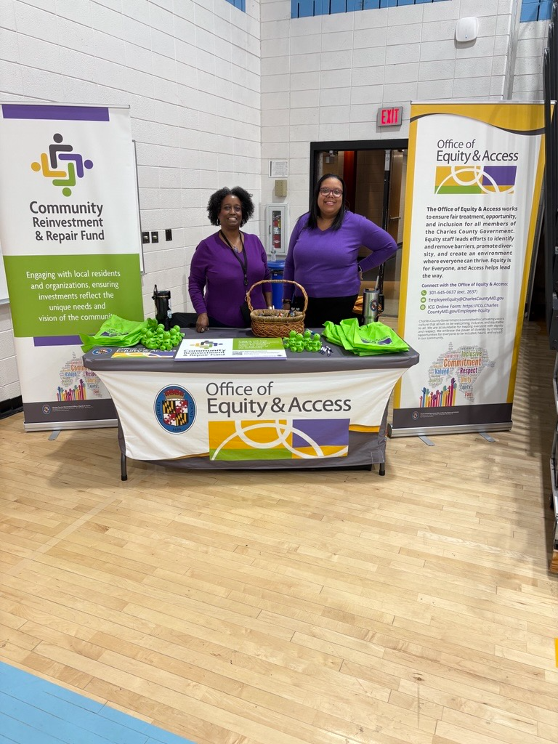
Next Steps
Enhancing community involvement and continuing to gather input to shape the CRRF into a successful initiative that elevates economic mobility for residents
Defining success through collecting data to track progress and impact
Expanding access beyond our typical circles and reaching higher than the “low hanging fruit”
Solidify the CRRF Workgroup by continuing to engage with the core team, key stakeholders, and including champions/community members

Slide 13

Community Conversation
Let’s talk about it!
We have 3 questions we would like to hear your thoughts on.
We will spend 20 minutes on each question (try to limit sharing to 2 minutes per person).
We will take a break before we start question 2.

Slide 14

Question # 1
What is something that would make your quality of life better?

Slide 15

BREAK TIME
10 Minutes

Slide 16

Question # 2
Is there anything making it hard for you to get what you need?

Slide 17

Question # 3
What programs or services would you like to have in your community?

Slide 18


Slide 19
BREAK TIME
5 Minutes

Slide 20

Questions about the CRRF….
Connect with the Office of Equity & Access
301-645-0637
CommunityEquity@CharlesCountyMD.gov
Thank You for Engaging with Us!

Slide 21


^{Charles County Government}
200 Baltimore Street • La Plata, Maryland 20646
301-645-0550 • 301-870-3000 • MD Relay Service: 7-1-1 • Relay TDD: 1-800-735-2258
^{Learn more at…}
^{www.CharlesCountyMD.gov}
Mission Statement – The mission of Charles County Government is to provide our citizens the highest quality service possible in a timely, efficient and courteous manner. To achieve this goal, our government must be operated in an open and accessible atmosphere, be based on comprehensive long- and short-term planning and have an appropriate managerial organization tempered by fiscal responsibility. We support and encourage efforts to grow a diverse workplace.
Vision Statement – Charles County is a place where all people thrive and businesses grow and prosper; where the preservation of our heritage and environment is paramount; where government services to its citizens are provided at the highest level of excellence; and where the quality of life is the best in the nation.
Equal Opportunity Employer – It is the policy of Charles County to provide equal employment opportunity to all persons regardless of race, color, sex, age, national origin, religious or political affiliation or opinion, disability, marital status, sexual orientation, genetic information, gender identity or expression, or any other status protected by law.

