Slide 1
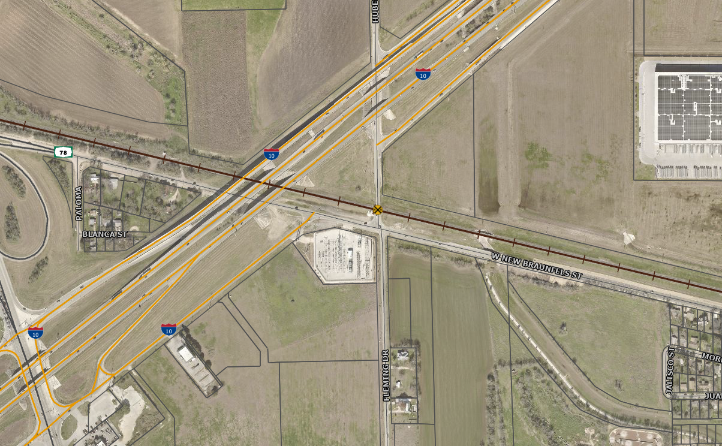

CITY OF SEGUIN OCTOBER 15, 2024
HUBER ROAD SAFETY IMPROVEMENT DICUSSION

Slide 2
History & Background
09/2022 – Railroad Quiet Zone feasibility analyzed (Staff Level)
02/2024 – Railroad Quiet Zone Professional Services Contract awarded
08/2024 – Diagnostic Review Team Meeting
10/2022 Development TIA
  Signal required at Hwy 78 & Huber with first phase
TxDOT Signal Warrant Study
  Signal improvements warranted but not yet funded
TxDOT Rail Division and UPRR recommendations for safety improvements
  Vertical grade challenged crossing
Notes:
Sept 2022: The City of Seguin has 6 at-grade rail crossings within its City limits. Each poses unique challenges to the requirements to create a Quiet Zone. The FRA Train Horn Rule (49 CFR 222) requires an engineer to sound the horn under various circumstances including when a train is approaching and passing through a public highway-rail grade crossing. In 1994, Congress ordered the FRA to enact federal regulations requiring train horns to be sounded at all public highway-rail grade crossings. In 2005, the final rule on quiet zones and the removal of the requirement to sound a horn was adopted and placed in the Code of Federal Regulations. This final rule allows for an FRA exemption to the Train Horn Rule requiring trains to sound their horns at at-grade crossings

Slide 3
Concerns at Huber Road
Signals within close proximity to a railroad crossing
  Backing of traffic on tracks leads to train-vehicle collision risk.
Off-Set Intersection – Huber & Fleming
  Adds to visibility issue
  Adds to dual conflict points
Humped Crossing – Grade issue
  Risk for vehicles to become stuck on tracks due to rate of change in the roadway grade
  Adds to visibility issue

Slide 4
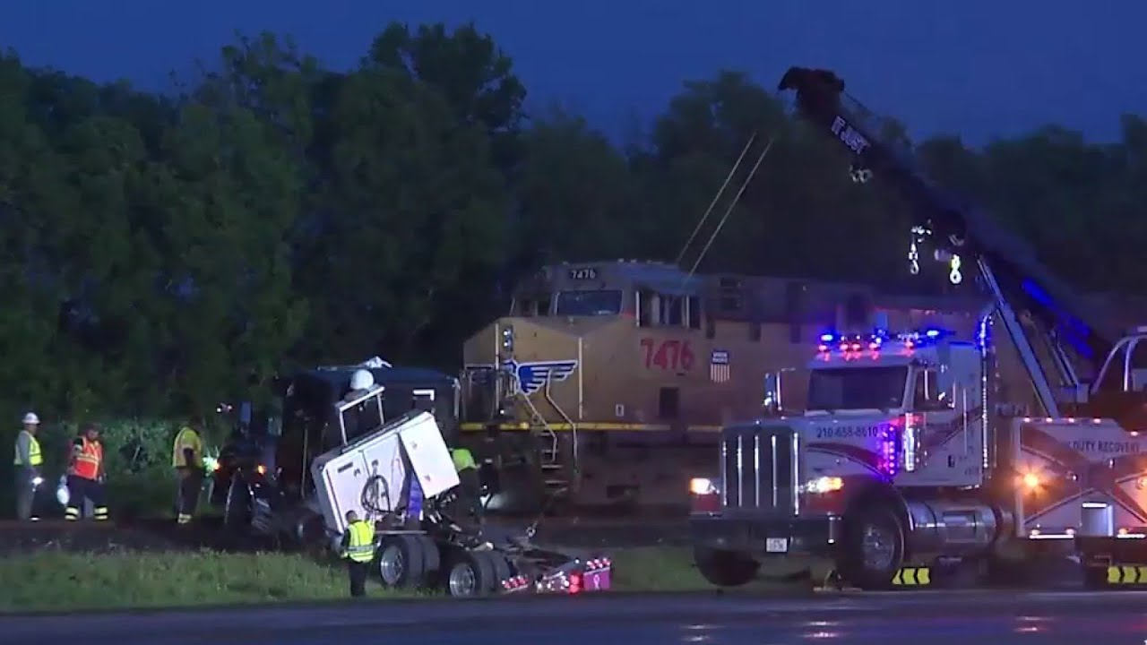
Traffic Signal Concerns
Traffic Signal Proximity to Crossing
  Adds significant risk of train collision
  Vehicles likely to stop on tracks
    Humped crossings increase this risk due to lack of visibility

Slide 5
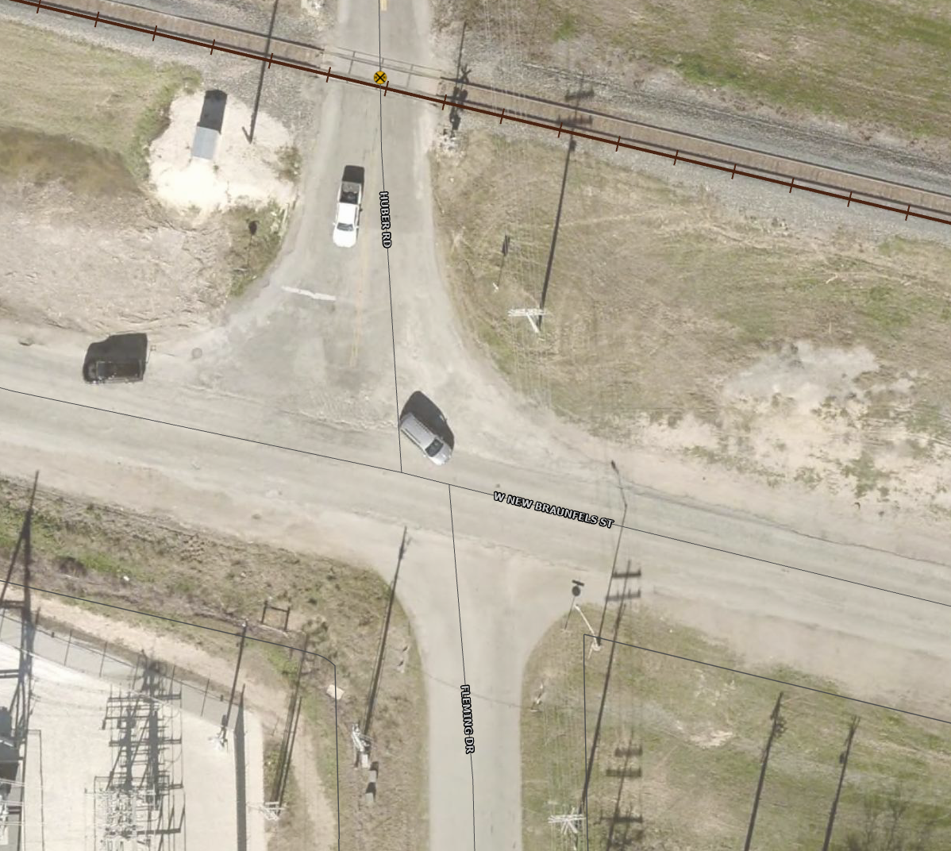
Intersection Horizontal Geometry Concerns
Off-Set Intersection
  Adds to visibility issue
  Adds additional conflict points
  More complicated signal design

Slide 6
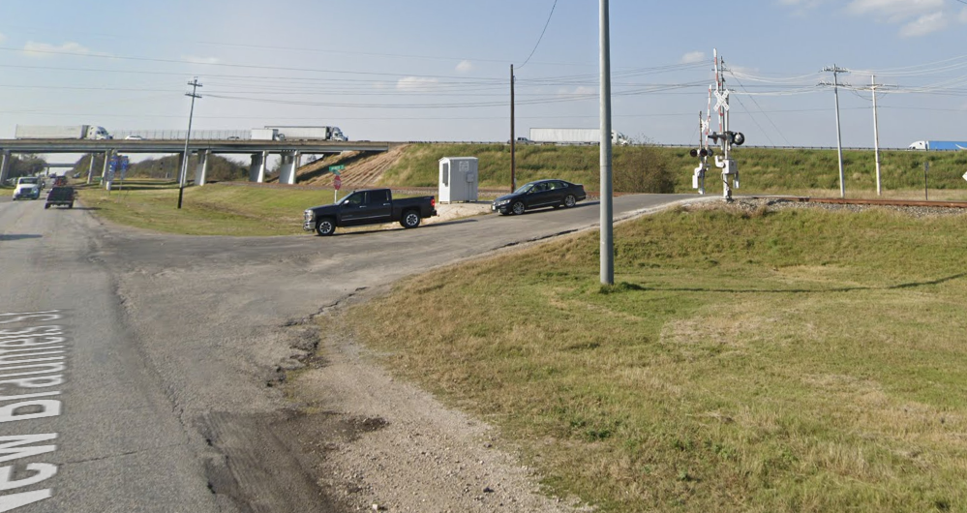
Vertical Grade Concerns
Grade issue – Humped Crossing
  Risks of high-centering
  Sight distance and visibility challenges
  The maximum approach grade should not exceed 3 inches of the rail elevation at a point 30 feet away from the center of the nearest rail on both sides of the crossing.
    Huber height difference equates to over 10” across 30’
Notes:
Significant grades can cause the following problems:
Low-clearance and long wheelbase vehicles can get stuck on the track at the crossing.
Crossing surface or field panels can become loose or dislodged if a vehicle catches on the approach edge of the panel.
Inadequate turning radius from the adjacent road, causing vehicles to leave the paved roadway, which could lead to the vehicle stalling on the crossing.
Adjusting the roadway profile to eliminate problems with humped crossings can add significant cost to the project. The maximum approach grade should not exceed 3 inches of the rail elevation at a point 30 feet away from the center of the nearest rail on both sides of the crossing. (Huber: 3’ height difference over 105’ distance equates to 10.3” over 30’)
Guidance adopted by the American Association of State Highway and Transportation Officials, recommends that the surface of the highway be not more than 75 millimeters (3 inches) higher or lower than the top of the nearest rail at a point 7.5 meters (30 feet) from the rail, unless track superelevation dictates otherwise. 1 Beyond this, there is currently no formula or threshold for determining if a highway-rail grade crossing presents a risk for low ground clearance vehicles, or if it should be posted as such. The actual risk for vehicles to become stuck on tracks has more to do with the rate of change in the roadway grade than its magnitude

Slide 7

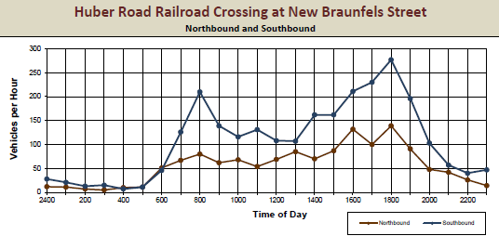
Traffic Volume
Train Data
25 Trains a day
  13 day
  12 night
Train speed 30 – 60mph
  Max measured 79mph
Notes:
Consultant data from RRQZ
Traffic Counts were taken on Thursday, March 21, 2024
FRA Inventory indicated AADT 849 in 2019

Slide 8
Traffic Incident Data
Notes:
Nearly 60 reports from Seguin PD
We only looked at the last 6 years

Slide 9
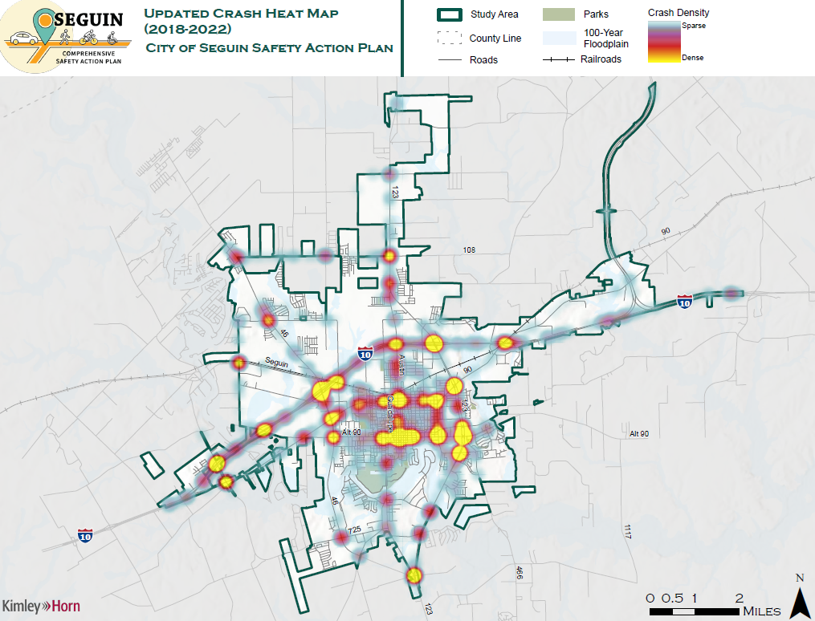
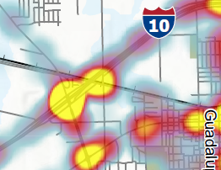

Slide 10
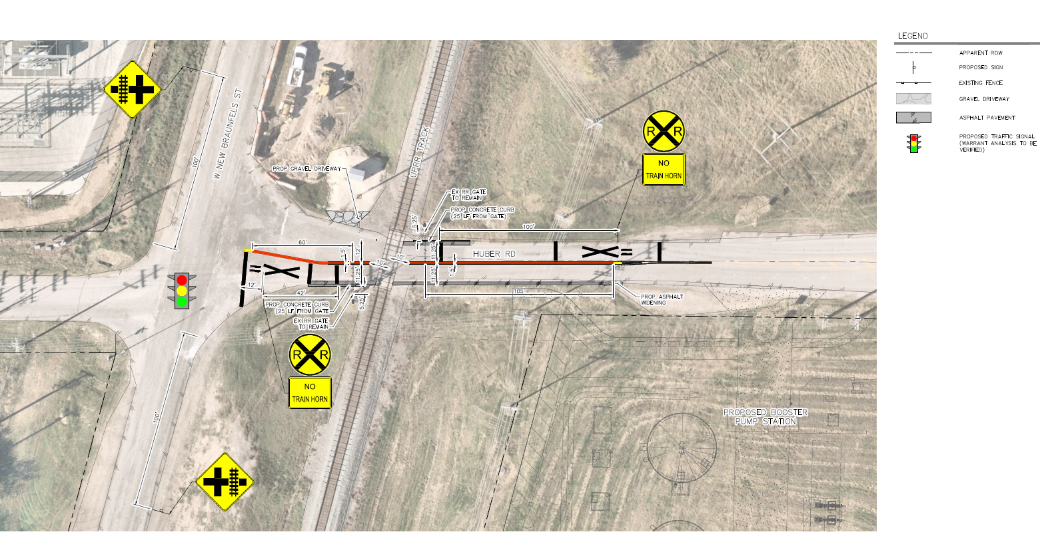
Option for Remaining Open
Notes:
median alignment will obstruct and/or make travel from Huber to/from Fleming difficult
Union Pacific has requested numerous improvements, many of which have implications on Hwy 78
hump correction: will require elevating Hwy 78 to correct the vertical grade differential – unclear how far that adjustment will take, but will have implications on Fleming and the substation driveway.
signal: correctly warranted, but not planned or funded.
Signal will add additional potential for traffic to stop on the tracks
Crossing improvements for UPRR are likely to be required for widening and pavement hump improvements.
Significant grades can cause the following problems:
Low-clearance and long wheelbase vehicles can get stuck on the track at the crossing.
Crossing surface or field panels can become loose or dislodged if a vehicle catches on the approach edge of the panel.
Inadequate turning radius from the adjacent road, causing vehicles to leave the paved roadway, which could lead to the vehicle stalling on the crossing.
Adjusting the roadway profile to eliminate problems with humped crossings can add significant cost to the project. The maximum approach grade should not exceed 3 inches of the rail elevation at a point 30 feet away from the center of the nearest rail on both sides of the crossing. (Huber: 3’ height difference over 105’ distance equates to 10.3” over 30’)

Slide 11
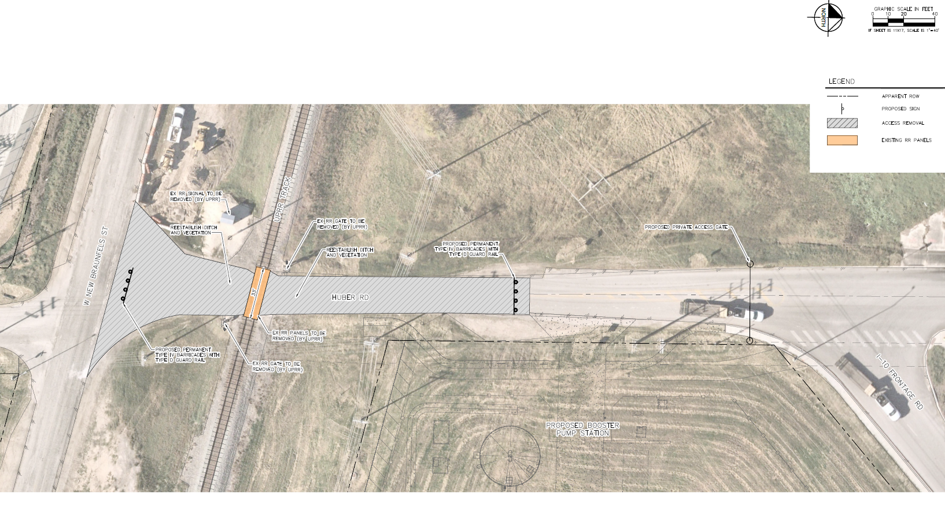
Option for Closure
Notes:
Removes all risk
Easiest and most financially beneficial option

Slide 12
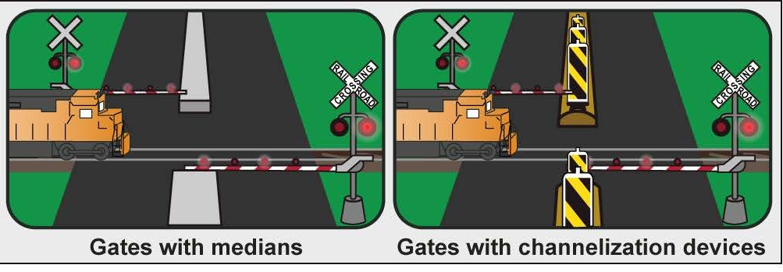
Quiet Zone Improvement Risk Reductions
Safety Measure | Estimated Risk (FRA) | Percent Change
Existing Condition (with Horns) | 65,329.13 | 0%
Existing Condition (without Horns) | 108,968.99 | 66.39% (increase)
QZ – Mountable Medians with Channelization Devices | 27,242.25 | -58.30% (decrease)
QZ – Non-traversable Curb Medians with or without Channelization Devices | 21,793.80 | -66.64% (decrease)
Closure | 0 | -100% (decrease)

Slide 13
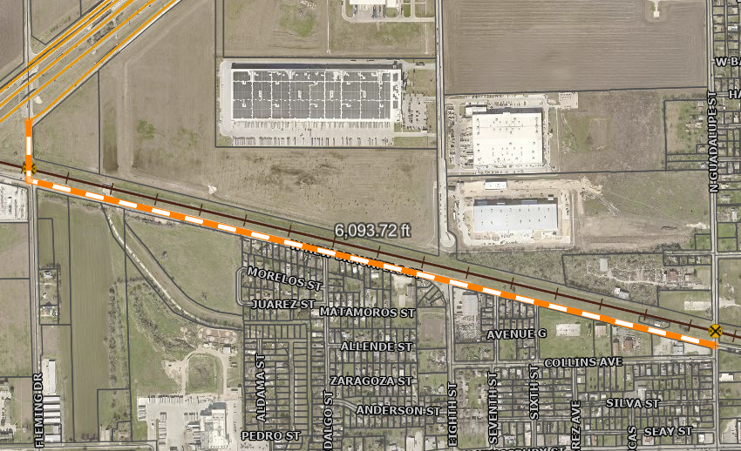
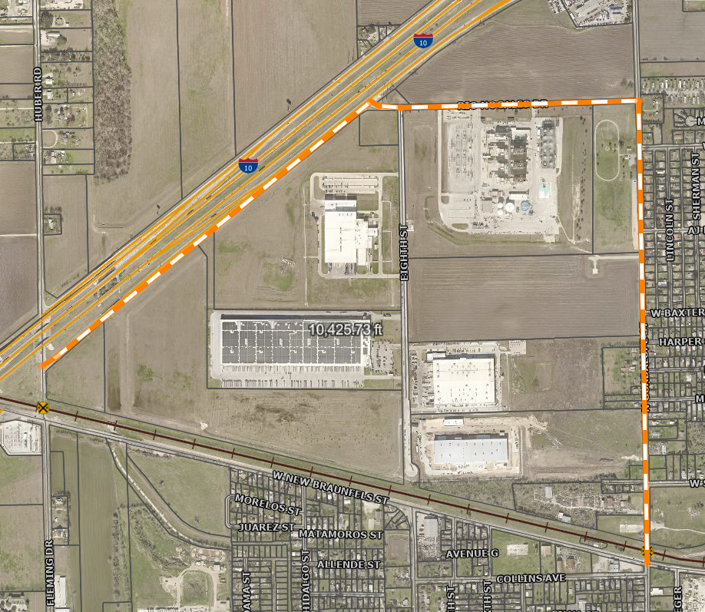
Approx. 4,330’ difference in length (0.8 miles)
  Less than 2 minutes drive time
  Less stop conditions
  Closures will be periodic over the course of construction for IH-10

Slide 14
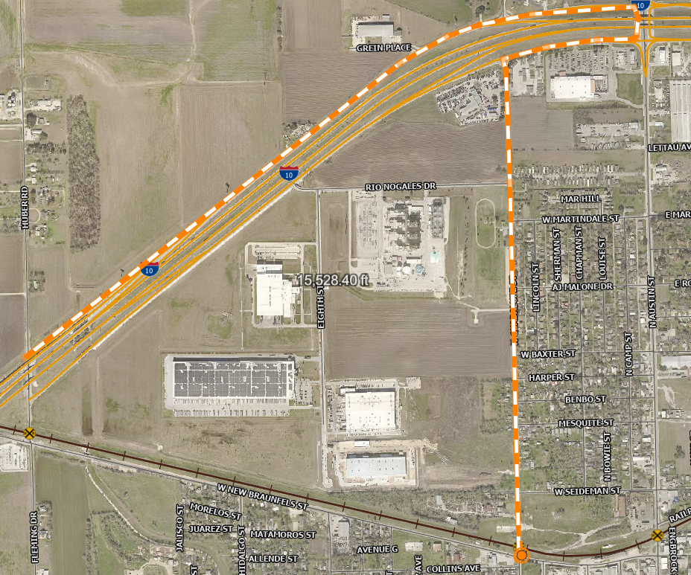
Approx. 9,435’ difference in length (1.8 miles)
  Less than 4 minutes drive time
  Closures will be periodic over the course of construction for IH-10

Slide 15
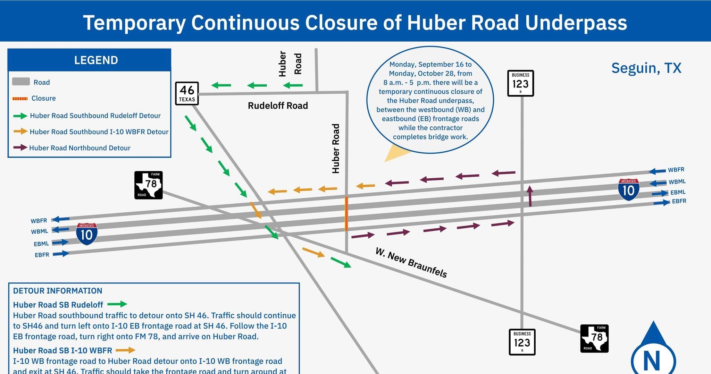

Slide 16
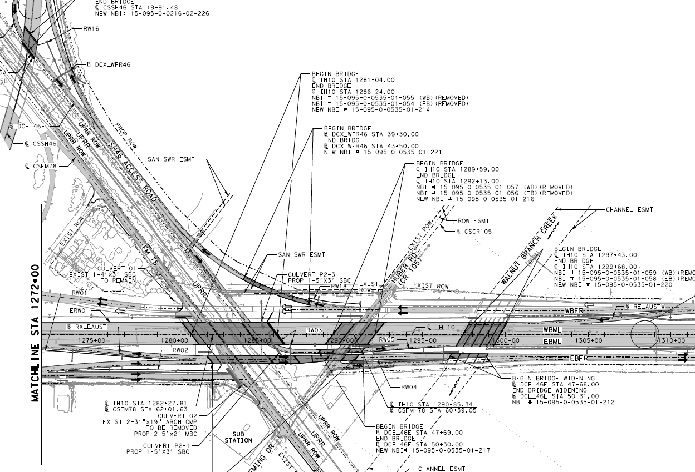
TxDOT IH 10
Notes:
Direct connects will allow access from Huber to Hwy 46
Hwy 46 to IH 10 will come down after Huber/IH10 intersection

Slide 17


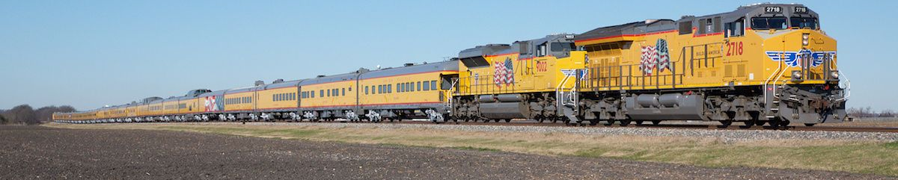
Financial Incentives
FRA
  Railroad Crossing Elimination Grant Program
TxDOT Section 130 – Closure Program
  Match railroad contribution up to $100k to be used for roadway, safety, and operational improvements.
  Railway-Highway Crossings Program
Union Pacific Railroad – Bipartisan Infrastructure Law
  Incentive Payments
Notes:
Texas came in #1 for train-vehicle at-grade crossing collisions in 2022. The state racked up 239 accidents
FRA - Railroad Crossing Elimination Grant Program: This program provides funding for highway-rail or pathway-rail grade crossing improvement projects that focus on improving the safety and mobility of people and goods.
I’m not sure applying for a grant at this stage would be worthwhile, but it is something we would vet with this process.
TxDOT 130 Program - Under the Basic Closure Program, TxDOT may offer up to $100,000 to a local government to close a public at-grade crossing;
TxDOT makes funding available to local governments for the following related improvements:
Removal of the existing pavement at the crossing.
Construction of a satisfactory terminus of the roadway at the removed crossing.
Installation of proper signs acknowledging the closing of the crossing.
Upgrades to the existing railroad signals.
Improvements to the existing streets near the closed crossing to handle the diverted traffic.
Section 130 program can match the railroad contribution up to $100,000 from TxDOT to the local government per individual public road closure. The local government must use the Section 130 funds from TxDOT only for roadway, safety and operational improvements associated with the crossing closure within the vicinity of the closed crossing, as approved in advance by TxDOT. The railroad company contribution may add incentive dollars, which can be used at the local government's discretion. The railroad contribution may include in-kind service such as removal of the crossing surface and warning devices.
FHWA - Railway-Highway Crossings Program (RHCP)
The Bipartisan Infrastructure Law (BIL) continues the Railway-Highway Crossings Program (RHCP), which provides funds for safety improvements to reduce the number of fatalities, injuries, and crashes at public railway-highway grade crossings.
Incentive Payments
Subject to certain conditions, the BIL increases the maximum payment that a State may pay a local government for permanently closing a public at-grade railway-highway crossing to the lesser of—
the amount of the incentive payment that the railroad owning the tracks on which the crossing is located paid to the government; or
$100,000 (vs. $7,500 under the FAST Act).
[§ 11108(c); 23 U.S.C. 130(i)(3)(B)]

Slide 18
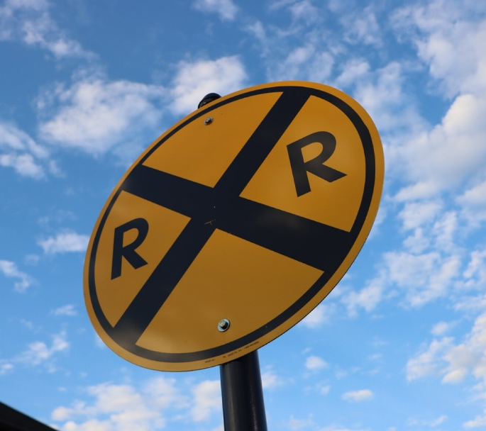
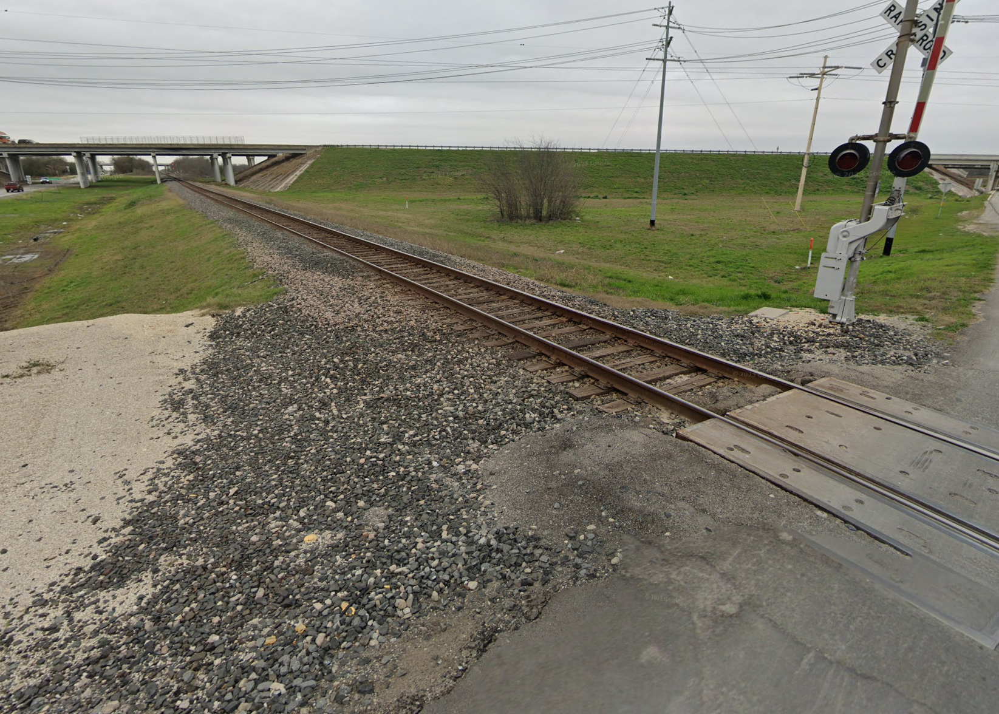
Final Thoughts
Quiet Zone is not dependent on Closure
Safety concern is primary
Direction for design option would aid in discussions as Quiet Zone Project progresses.
If closure is the direction provided a Resolution will come back to Council for authorization.
Notes:
If closure is the direction provided a Resolution will come back to Council for authorization.

Slide 19
Questions?

Slide 20
