Slide 1
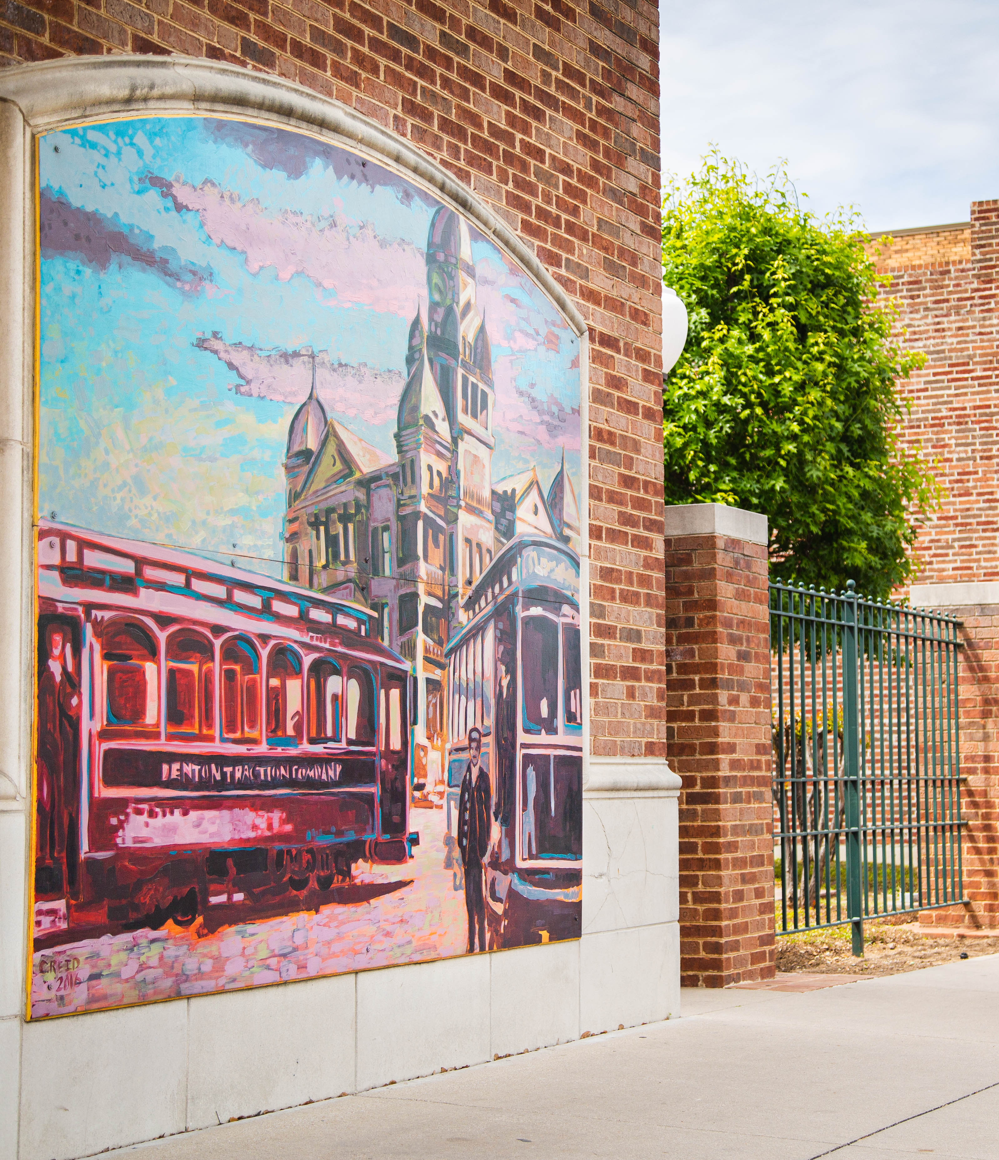

DDC 7.7.4: Tree Preservation
DCRC25-095M 4/13/2026

Slide 2
Tree Code Review
Why are we here
Process
Late 2024: City Council prioritized a review of the Tree Code.
December 9, 2024: DCRC held a discussion prioritizing future topics. Staff directed to review Tree Code.
Staff worked internally to identify areas needing revision
DCRC review and direction provided between April 2025 and April 2026
DCRC25-095M 4/13/2026

Slide 3
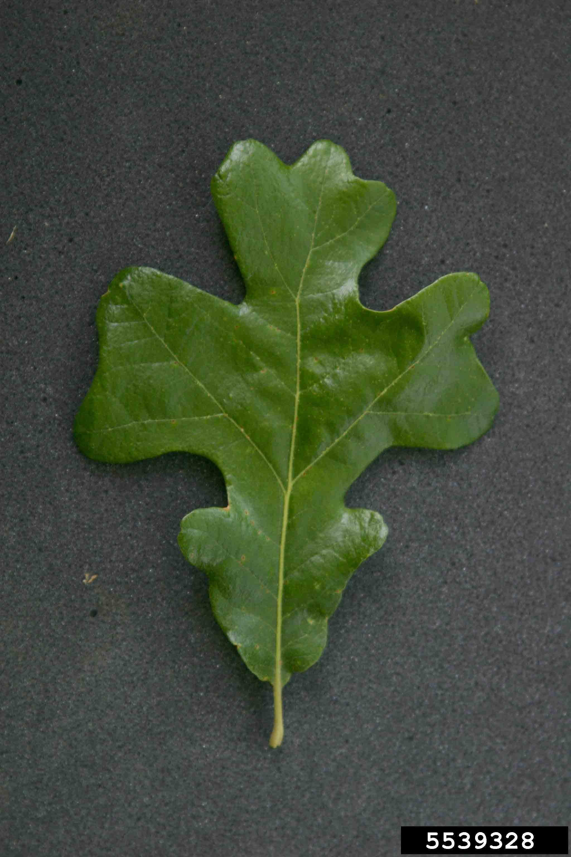
Tree Code Review
Key areas of focus
Emphasis on Heritage trees
Protection during construction
Industry best standards
Revise available incentives
Updates to definitions
DCRC25-095M 4/13/2026

Slide 4
Addressing Focus Areas
Emphasis on Heritage Trees
Protection during construction
Improved minimum tree protection fencing area for Heritage Trees
Required chain link fencing for Heritage Trees
Increased replacement rate and preservation credit for Heritage Trees
Specification regarding location of tree protection fencing
Requirement of arborist plan for trees to be impacted by more than 20% of the area within the dripline
Revised existing language for clarity
DCRC25-095M 4/13/2026

Slide 5
Addressing Focus Areas
Industry best standards
Updates to definitions
Approved Tree Preservation Plan expiration time period
Revised “certified professional” list
Improved construction protections
Provided minimum soil volume for mitigation trees
Revised Heritage Tree definition to prioritize keystone species
Included “Fair” tree health category
Updated invasive species list
DCRC25-095M 4/13/2026

Slide 6
Incentive Amendments
Upland habitat ESA preservation incentive
Incentivized understory preservation
Invasive species removal incentive
Height increase allowed where additional height allows for the preservation of trees
Off-site trees: may be granted slight preservation credit if protected
Trees adjacent to a residential property may be given additional preservation credit
DCRC25-095M 4/13/2026

Slide 7
Miscellaneous Amendments
TLGC 40-50% reduction removed
Size categories within Heritage and Quality definitions
6”-12”
12”-24”
24”+
Sites applying for reduced preservation will pay higher mitigation rates for all trees, rather than the 10% delta
Tree Preservation Relief approved to be processed through the Zoning Board of Adjustment, rather than City Council
Infill Development considerations
DCRC25-095M 4/13/2026

Slide 8
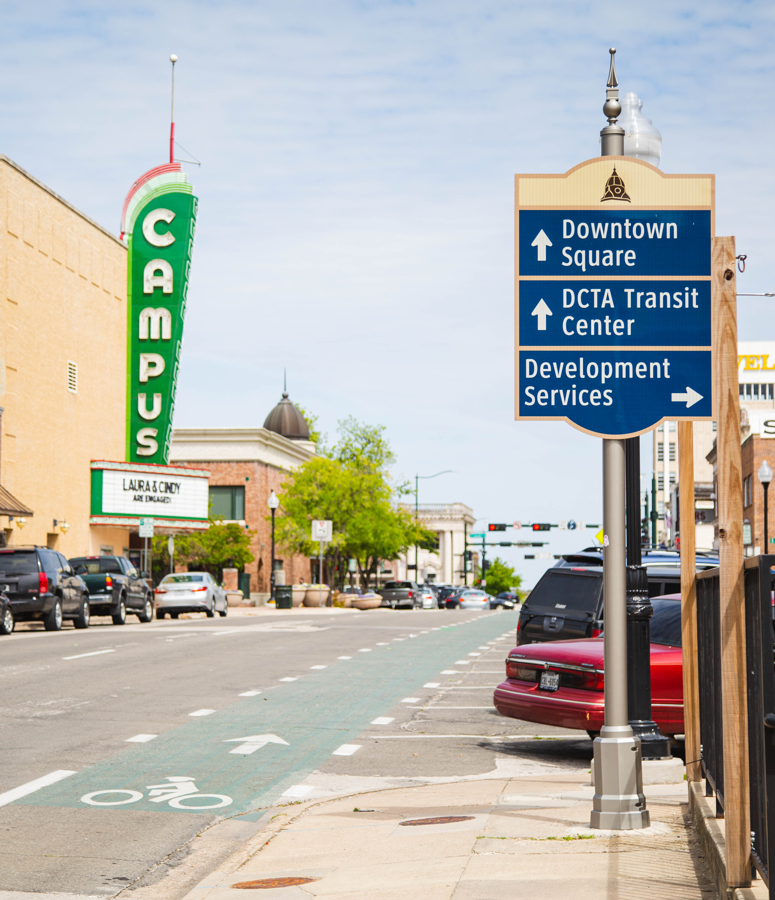
Questions
DCRC25-095M 4/13/2026

