Slide 1


Welcome to the Getty St. Round Table
Date: February 20, 2025
Purpose: To foster collaboration between the business community, city staff, and stakeholders to enhance the Getty St. Corridor
Please Sign in
Grab Lunch Provided by Kayla’s Tacos

Slide 2

Agenda
Welcome & Introductions
Meet the Economic Development & Planning Department
Welcome Public Safety Officers Abel & Fountain
Apple Avenue Redesign Update
Identity & Vision for Getty St.
Next Meeting Date & Closing Remarks

Slide 3

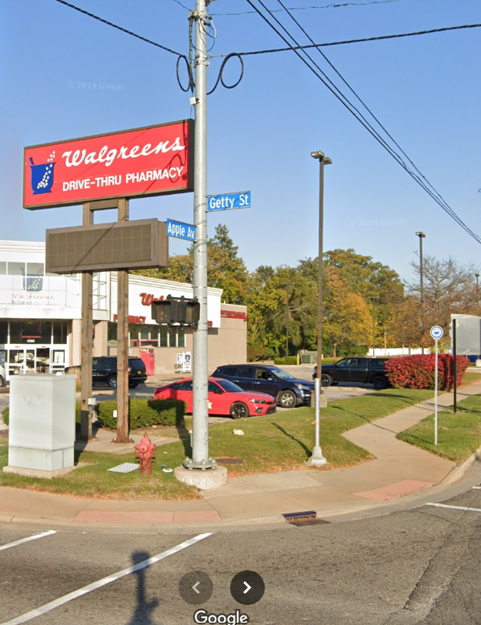
Introductions
Brief welcome and attendee introductions
Purpose of the round table discussion
Your Name
Organization/Business
One word to describe what you love about the Getty St. Corridor

Slide 4
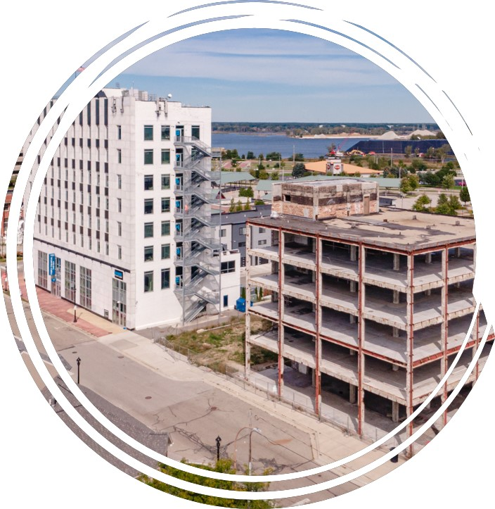
Meet the Economic Development & Planning Department
Overview of the department's role
Key projects and initiatives in the area
How the department supports community growth

Slide 5
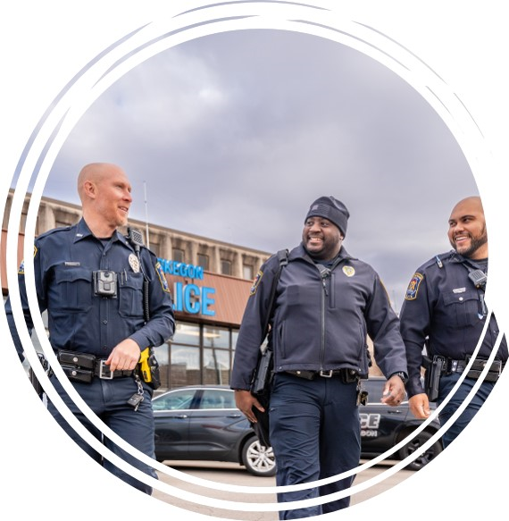
Welcome Public Safety Officers Abel & Fountain
Introduction of Officers Abel & Fountain
Their roles and responsibilities in the community
How public safety collaborates with residents
Q&A

Slide 6
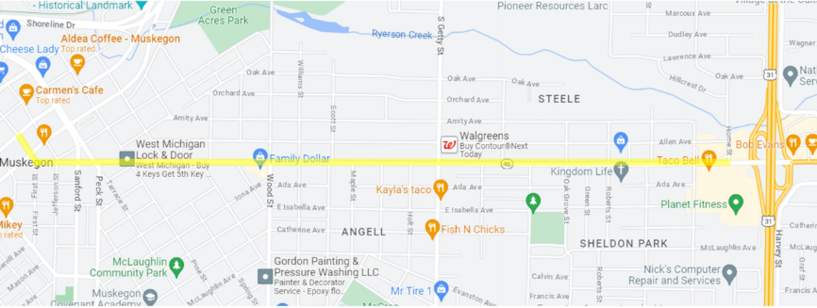
Apple Avenue Redesign Update
Presented by Director of Public Works, Dan VanderHeide
Project overview
MDOT 2026 M-46 Reconstruction Project Plan Review
  Feb. 24, 2025 from 4-5:30pm, City Hall Commission Chambers
Getty St. Traffic Study
Q&A

Slide 7
Identity & Vision for Getty St.
Community Branding and Identity
What improvements do you want to see? (Updated sidewalks, bike paths, more parking etc.)
Vision and Goals

Slide 8



Thank You
Contessa Alexander
231-724-4141
Contessa.alexander@shorelinecity.com

