Slide 1
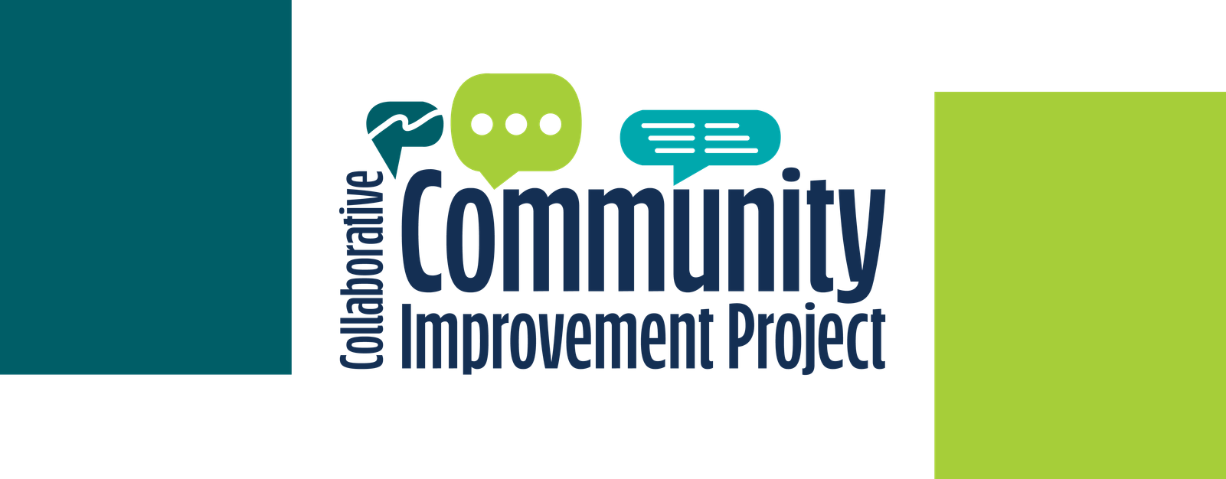
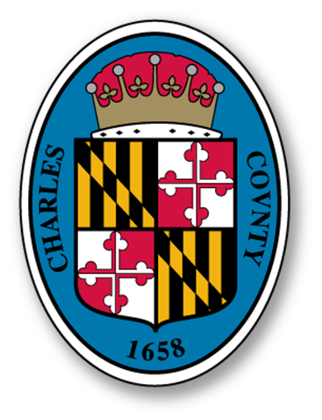
Charles County Government
Collaborative Community Improvement Project (CCIP)
Update for the Board of County Commissioners
July 21, 2026

Slide 2
Project Update
Where We Started
  Approved funding for pilot program: Collaborative Community Improvement Project, with selection of Bryans Road/Indian Head as the community of focus.
  $500,000 in Capitol Improvement Projects and $150,000 in Operational Funding
  Development of 2 working groups: one internal and one external
Where We’ve Been
  High Notes!
    Two community meetings in August 2025: one virtual and one in-person
    Multiple meetings with internal employee working group
    3 virtual meetings with external working group
    Two community surveys
      August-September 2025- General sentiment on what would improve community
        122 respondents
      February-March 2026- Ranking of potential projects
        128 respondents
    Exciting and diverse internal and external collaboration efforts!
  Hurdles....
    Realization of limitations of Equity Emphasis Area boundaries
    Reality of speed of government
    Inability to address ALL community needs and wants

Slide 3

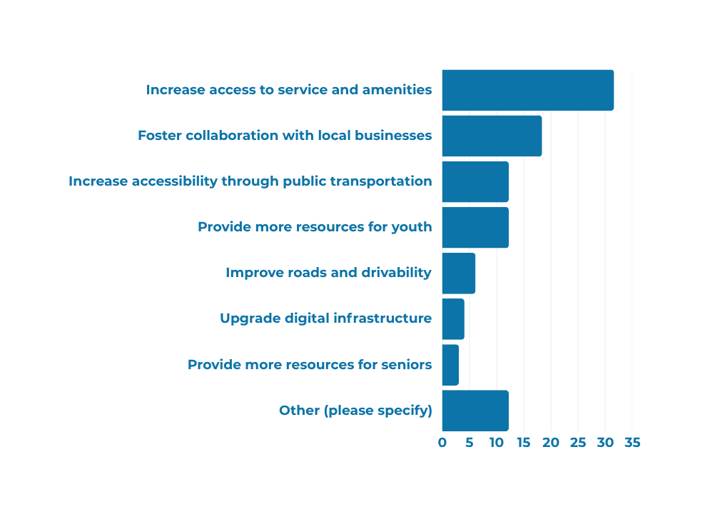




Survey #1
Overview of Feedback
Who participated?
Quality of Services
Top 3 Priorities Spotlight
122 participants
76% live in Bryans Road/Indian Head
6% work in Bryans Road/Indian Head
11% live and work in Bryans Road/Indian Head
Participants were asked to select the most important thing Charles County can do to improve quality of services.
Access to Service and Amenities
Collaboration with Local Businesses
Accessibility through Public Transportation
How were people reached?
Residents who live in Bryans Road/Indian Head overwhelmingly prioritized increasing access to services and amenities (31%), far surpassing other options.
  Flyers and yard signs
  Social media
  E-newsletter
  Community meetings and events
  Outreach to key
stakeholders

Slide 4
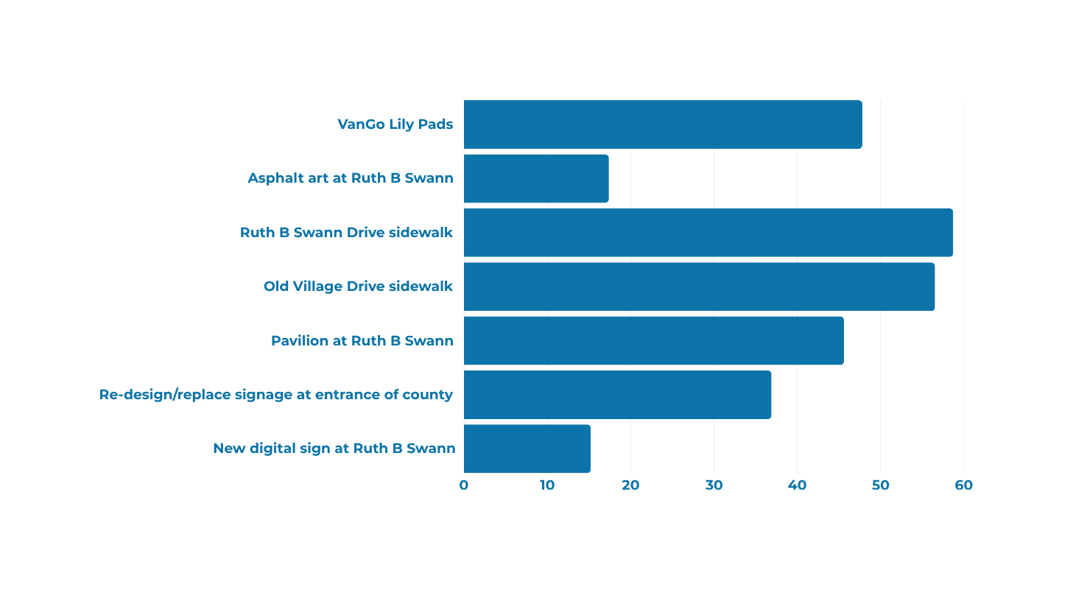
Survey #2
Overview of Feedback
Who participated?
Key Projects to Improve Community
128 participants
59% live in Bryans Road/Indian Head
7% work in Bryans Road/Indian Head
9% live and work in Bryans Road/Indian Head
Participants were asked to select the projects that they believe would improve Bryans Road/Indian Head.
How were people reached?
  Flyers and yard signs
  Social media
  E-newsletter
  Community meetings and events
  Outreach to key
stakeholders

Slide 5
Additional Feedback from External Working Group
Background of Internal Working Group
  Bryans Road has strong group of advocates/community leaders
  Communications & Engagement staff wanted to capitalize on the leaders and advocates already invested in the community to support this project
  This group of residents has advised on meeting times and locations; project promotion; etc.
Invited External Workgroup Members
  Dawud Abdur-Rahman, Bryans Road Business Association & Resident
  Yolanda Coleman-Brown, Resident
  Tammi Crank, Voices of Bryans Road & Resident
  Garvia Hill, Citizens Academy Ambassador & Resident
  Gloria Jolly, BRSC Community Outreach Center
  Bob Lukinic, Resident
  Angela Parker, Resident
  Daria Price Harris, Citizens Academy Ambassador & Resident
  Cheryl Robinson, The Master’s Child Church
  Michelle Talkington, HOA Leadership & Resident
  Hughes Valmond, JC Parks, CCPS
  DauVeen Walker, Potomac Branch, CCPL
Feedback from Internal Working Group
  Current project boundaries do not represent the actual Bryans Road community
  In order to feel like this project has value, the Village Green Park/shopping center area must be considered

Slide 6
Project Proposal in Ruth B. Swann Complex
  New digital sign at entrance of complex
    Library would manage and maintain, which supports their strategic plan. CCPL is in full support of this effort!
    Cost- Looking for estimates from previous projects
  VanGO Improvements
    Adding a VanGO stop to the entrance of Ruth B. Swann Park. The preferred option is to add a concrete ADA-compliant pad and lily pad at the edge of the park where it meets with MD-210
    Estimated cost $10K
  Pedestrian Access
    Dedicating space along Ruth B. Swann Drive as both a pedestrian lane separated from the traffic and incorporate elements of "arts in the right-of-way" (AROW). This is based on previous discussions and from observing a resident using portions of Ruth B Swann Drive for walking without a dedicated space. Some advisory information about pedestrian dedicated space can be found on the Rural Design Guide.
    Cost: PGM is working with Capital Services to determine estimate
  Wayfinding Signage & Maps
    Creating signage connecting the community and highlighting the activities and trails within the complex.
    Cost: Can gap-fill from other projects

Slide 7
Request for Inclusion of Village Green Park Project
  Village Green in Bryans Road
    Pocket park that is under utilized
    Has some resources from Resilience Authority
    Very central to the Bryans Road community
  Potential Partnership with Better Block
    Possible use of consultant with background in community development and improvement, with a foundation in involving community in the process
    Connection made through Assistant Chief of Planning, Tony Felts from previous work experience
  Background of Better Block
    The Better Block Foundation is a 501(c)(3) urban design nonprofit that educates, equips, and empowers communities to reshape and reactivate their built environments. We work alongside residents, local governments, businesses, and community organizations to turn ideas into action and create places that reflect the people who use them.
  Better Block’s Proposal
    Charles County has already invested significant time listening to the Bryans Road community. Through surveys, meetings, and conversations, residents have shared a clear vision for the future. They want places to gather, activities that bring people together, safer spaces for families, and a stronger sense of identity. Our role as we see it is to help turn that vision into something people can experience.
    Better Block believes the best way to plan for the future is to test it.
    For this project, Village Green becomes the place where those ideas come to life. By creating a year-long demonstration, the County and community can see what works, learn from how people use the space, and build the local stewardship needed to sustain it. The lessons learned in the park won’t stop at its edges. They’ll help inform future investments throughout the surrounding town center.

Slide 8
Better Block Proposal At-A-Glance
  4 Phase Implementation, Followed by Living Demonstration
    Phase 1: Organize (Days 1-30)
    Phase 2: Design (Days 31-60)
    Phase 3: Prepare (Days 61-115)
    Phase 4: Implementation & Demonstration (Days 115-120)
    Living Demonstration : Village Green will remain active for approximately 12 months, allowing the County and community to experience the space across different seasons, events, and everyday use. Better Block will identify local stewards, build a year-long activation plan, and organize the partnerships needed to keep the space active throughout the year. Once the project opens, the community takes the lead. Better Block will remain available through scheduled check-ins and ongoing consultation to provide support, troubleshoot challenges, and help the stewardship team as needed.
  Funding
    Combination of CIP and Operational
      CIP: approximately $60,000
      Operational: $140,000

Slide 9
Use of Possible Remaining CIP Funds, if Village Green is included
Old Village Drive Improvements:
  Extending the sidewalk from the existing terminus at the Village Green Park and extending it to the existing sidewalk at MD-210. This should be within County right-of-way, based on observation from GIS model. Based on a previous estimate by Capital Services, the cost should come out to around $50,000
  Repurposing the non-handicapped street parking spaces along Old Village Drive, to incorporate asphalt art and increase traffic calming.

Slide 10
Additional (non-capitol) CCIP projects
  Bryans Road/Indian Head “Neighbor” Academy
    A condensed Citizens Academy model program (2-4 classes) for residents in this area to learn specifically about their community. This program would be held in the CCPL Potomac Branch meeting room.
    This component will require pre-registration with a mandatory minimum to ensure maximization of employee resources
  ·Entrance to County Sign Improvements
    Improvements to signage and visibility to create more beautified entrance to county
    Department of Public Works is exploring ownership/right of way with State Highway Administration to determine ability to move forward
  Programming at Village Green Park
    Communications & Engagement team will work with departments, affiliate partners, and local non-profits to develop opportunities for community gathering and programming in this space. .
  More Intentional Use of Green Space in Village Green
    Balancing security with native grasses to ensure protection of environment, enhance community attractiveness, and promote a more welcoming environment

Slide 11
Moving Forward
  FEEDBACK: Are you comfortable with the direction in which we are moving?
  QUESTIONS: Do you have any questions about the proposed projects?
  APPROVAL?: Will you approve extension of project boundaries to include Village Green Park?
Thank you for your time and consideration!

